Slide 1
JOURNEY SCRAPBOOK
Custom Bootcamp (29th August – 6th October)
Week-4
Radhika Tibrewal

Slide 2
DAY-1
Function
Function Composition
Recursive Function
Generator Function
Decorator (Wrap Function)
Types Of Argument
Class
Date Stripping
Date Conversion
Exception Handling
List Comprehension
Lambda Function
Python – Day 2

Slide 3
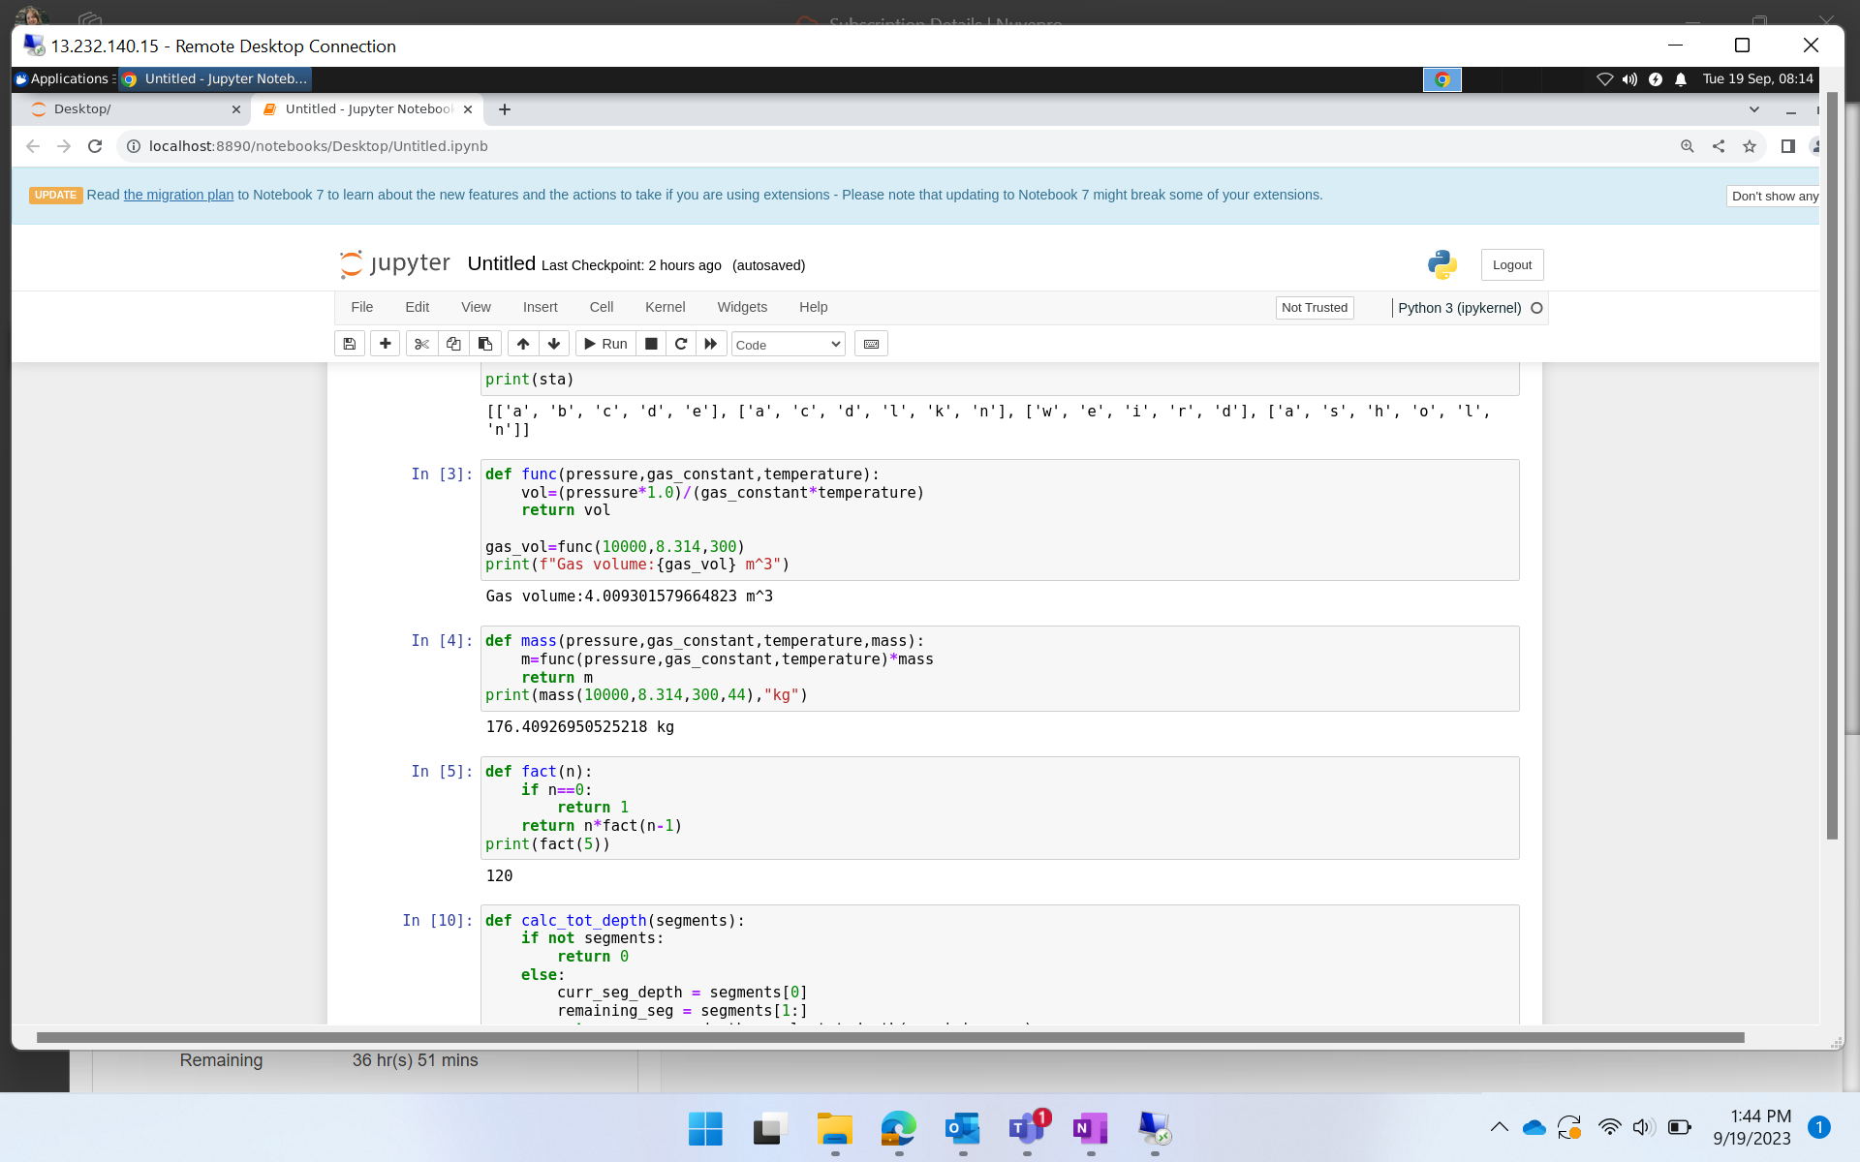
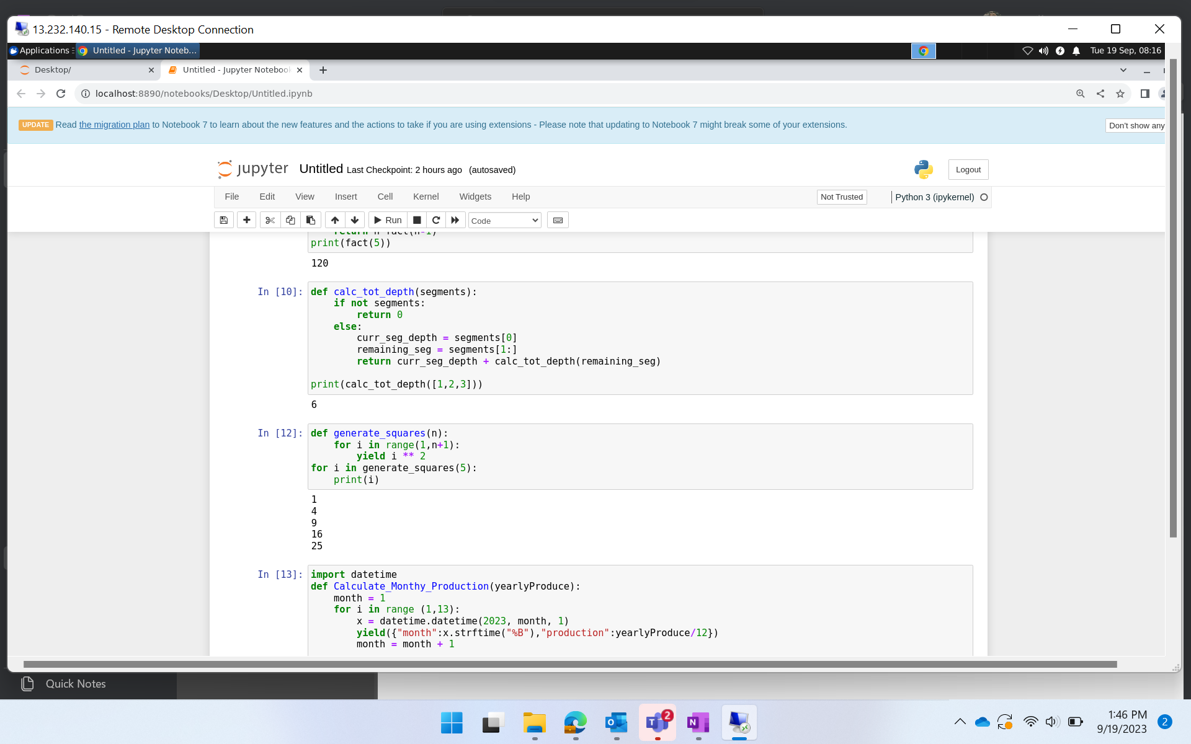
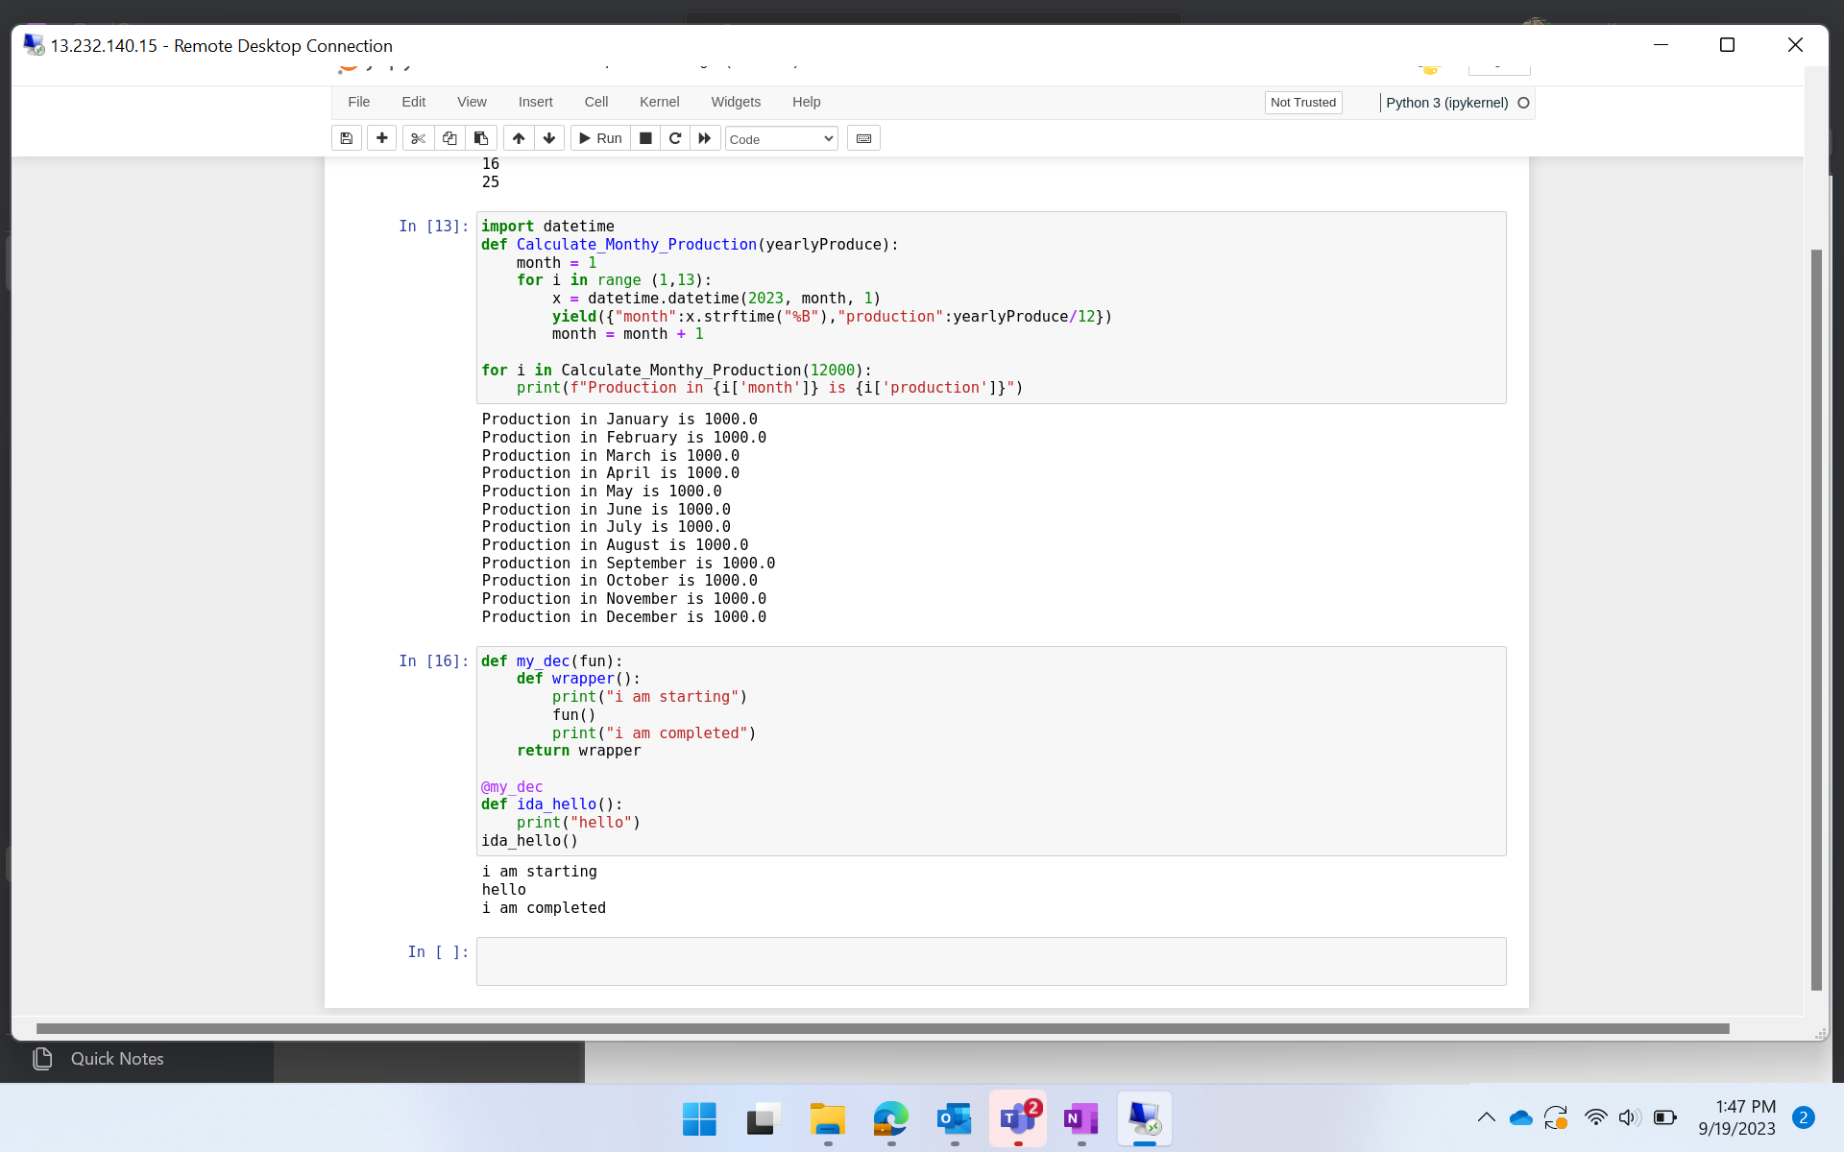
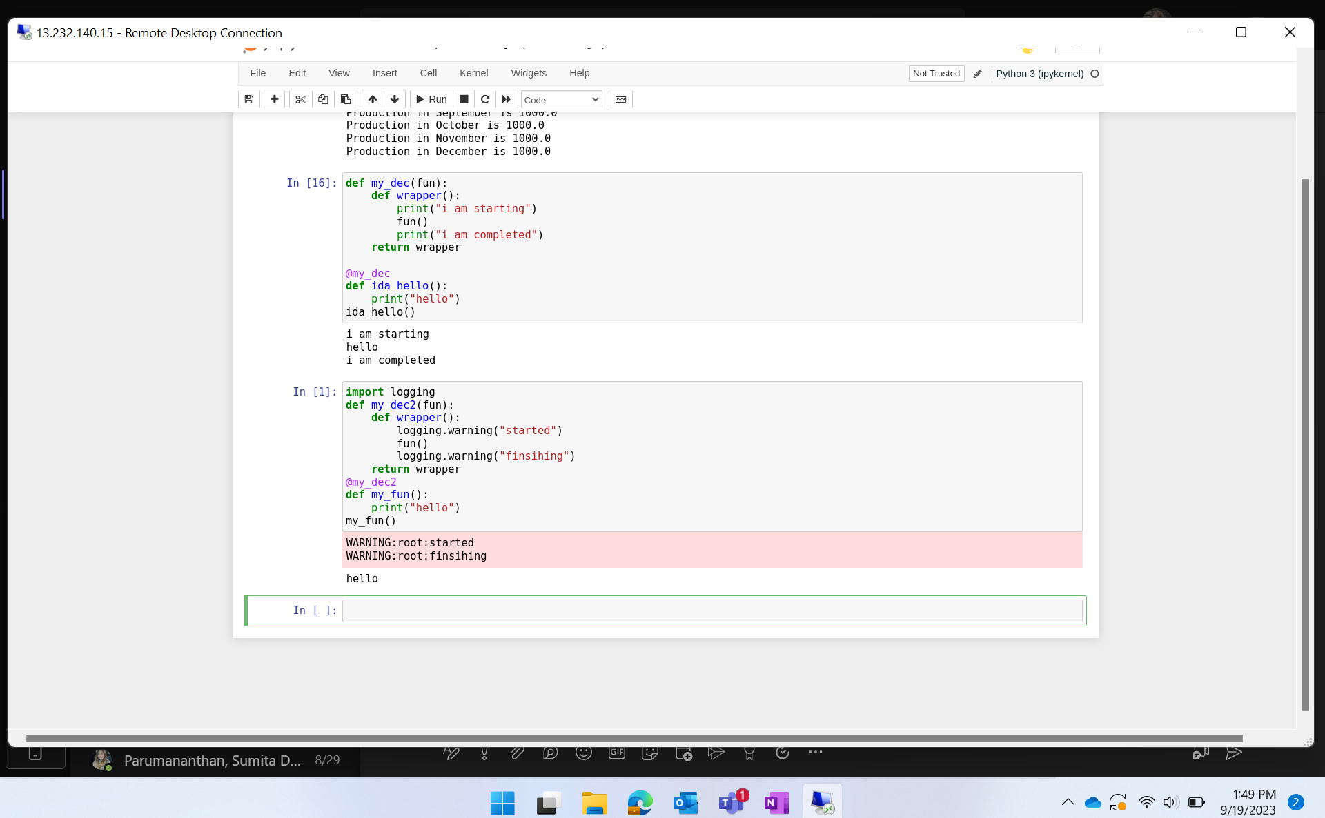
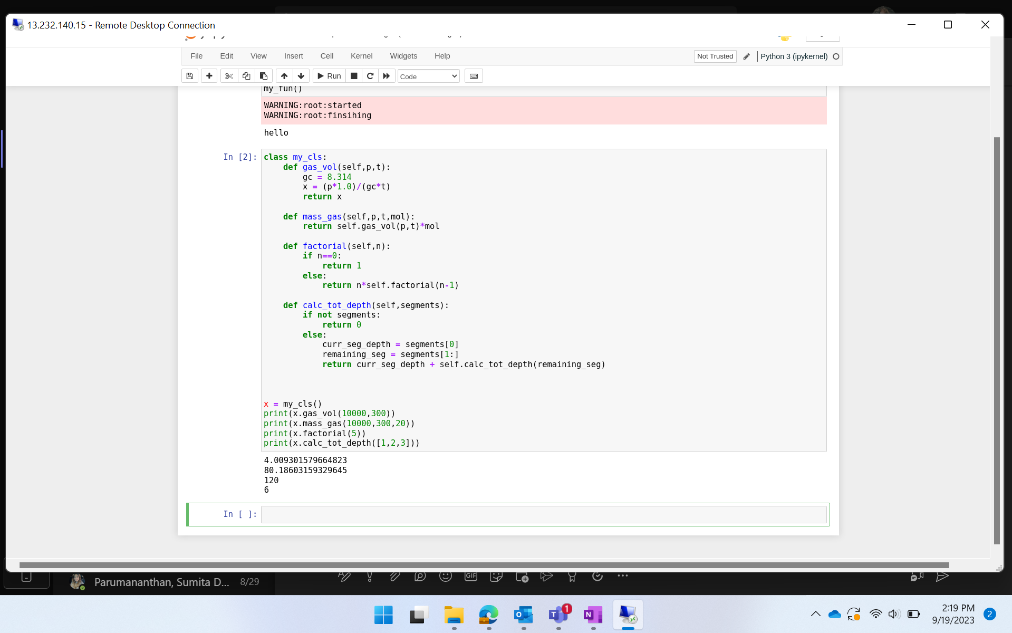
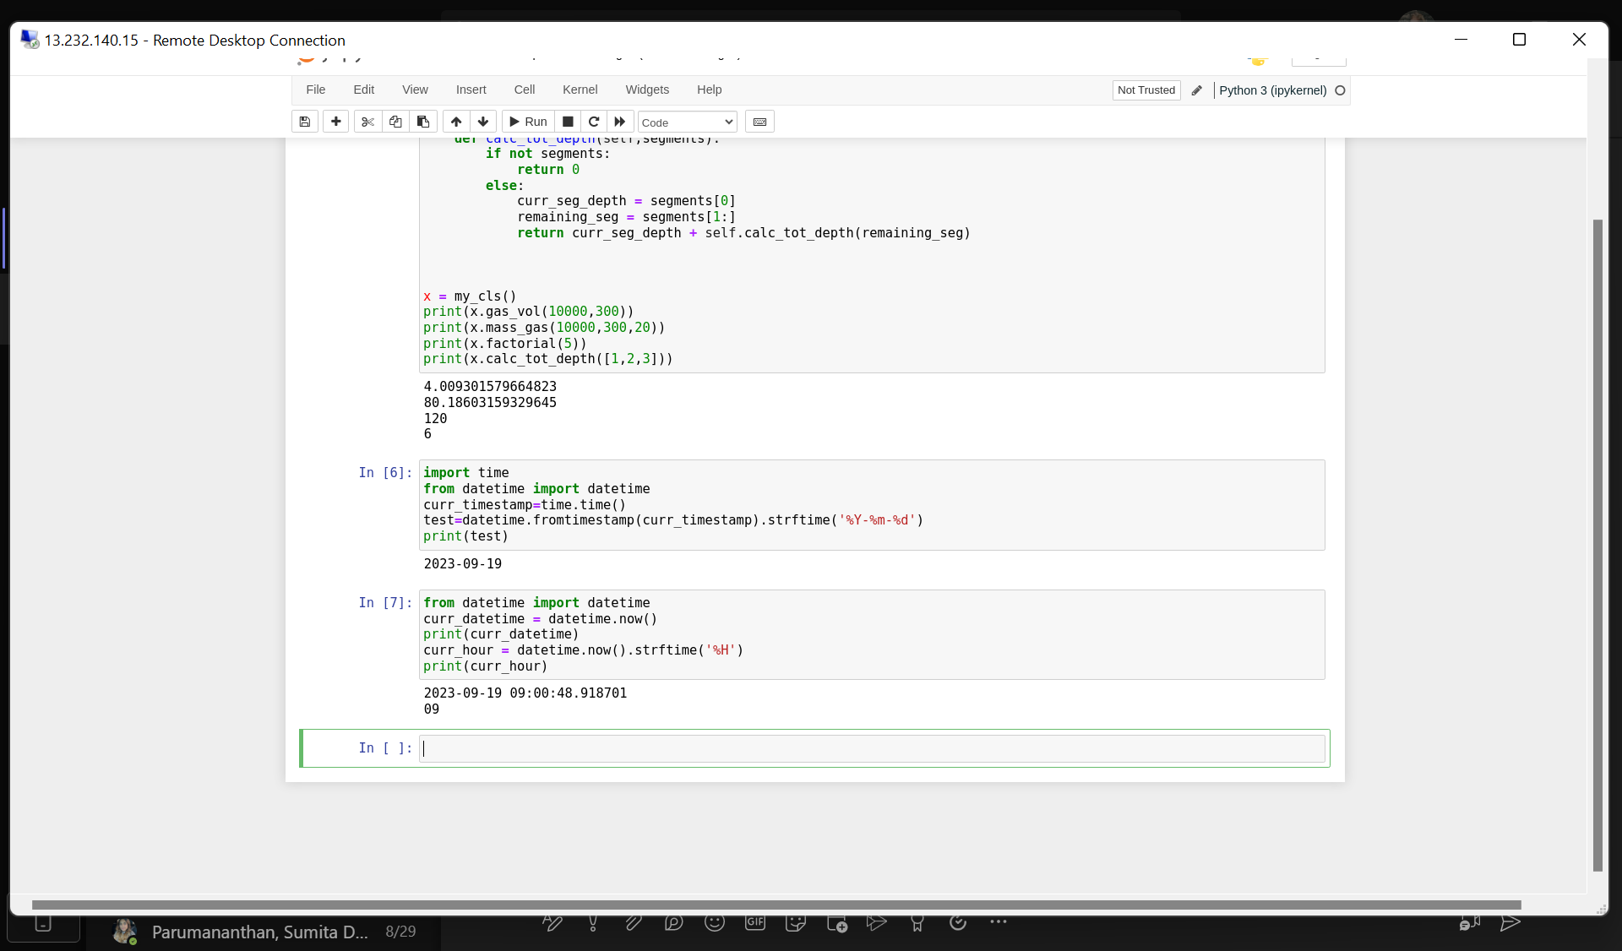
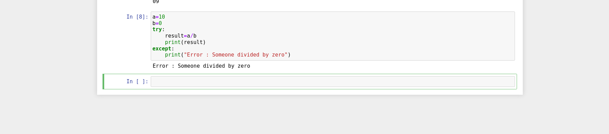
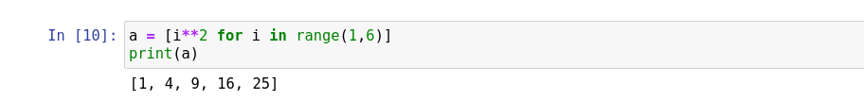
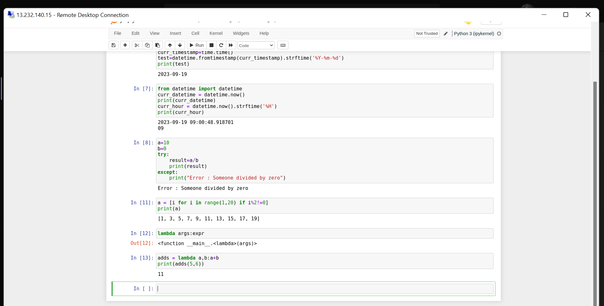

Slide 4
DAY-2
1. Pandas : Panel Datasets
a. Dataframe
b. Functions on dataframe
c. Changing column to lowercase
d. Dropping Null Values
e. Dropping columns with Null Values
f. Filling null values
g. Describe columns
h. Value counts()
i. Selected rows or columns of dataframe
j. Conditional selection
2. Matplotlib
3. Arrays In Python
Python – Day 3

Slide 5
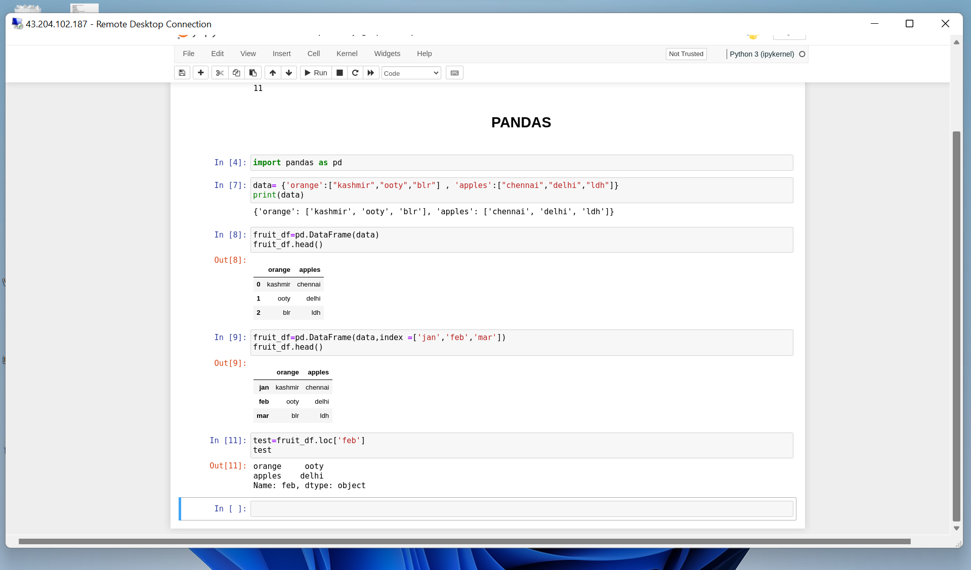
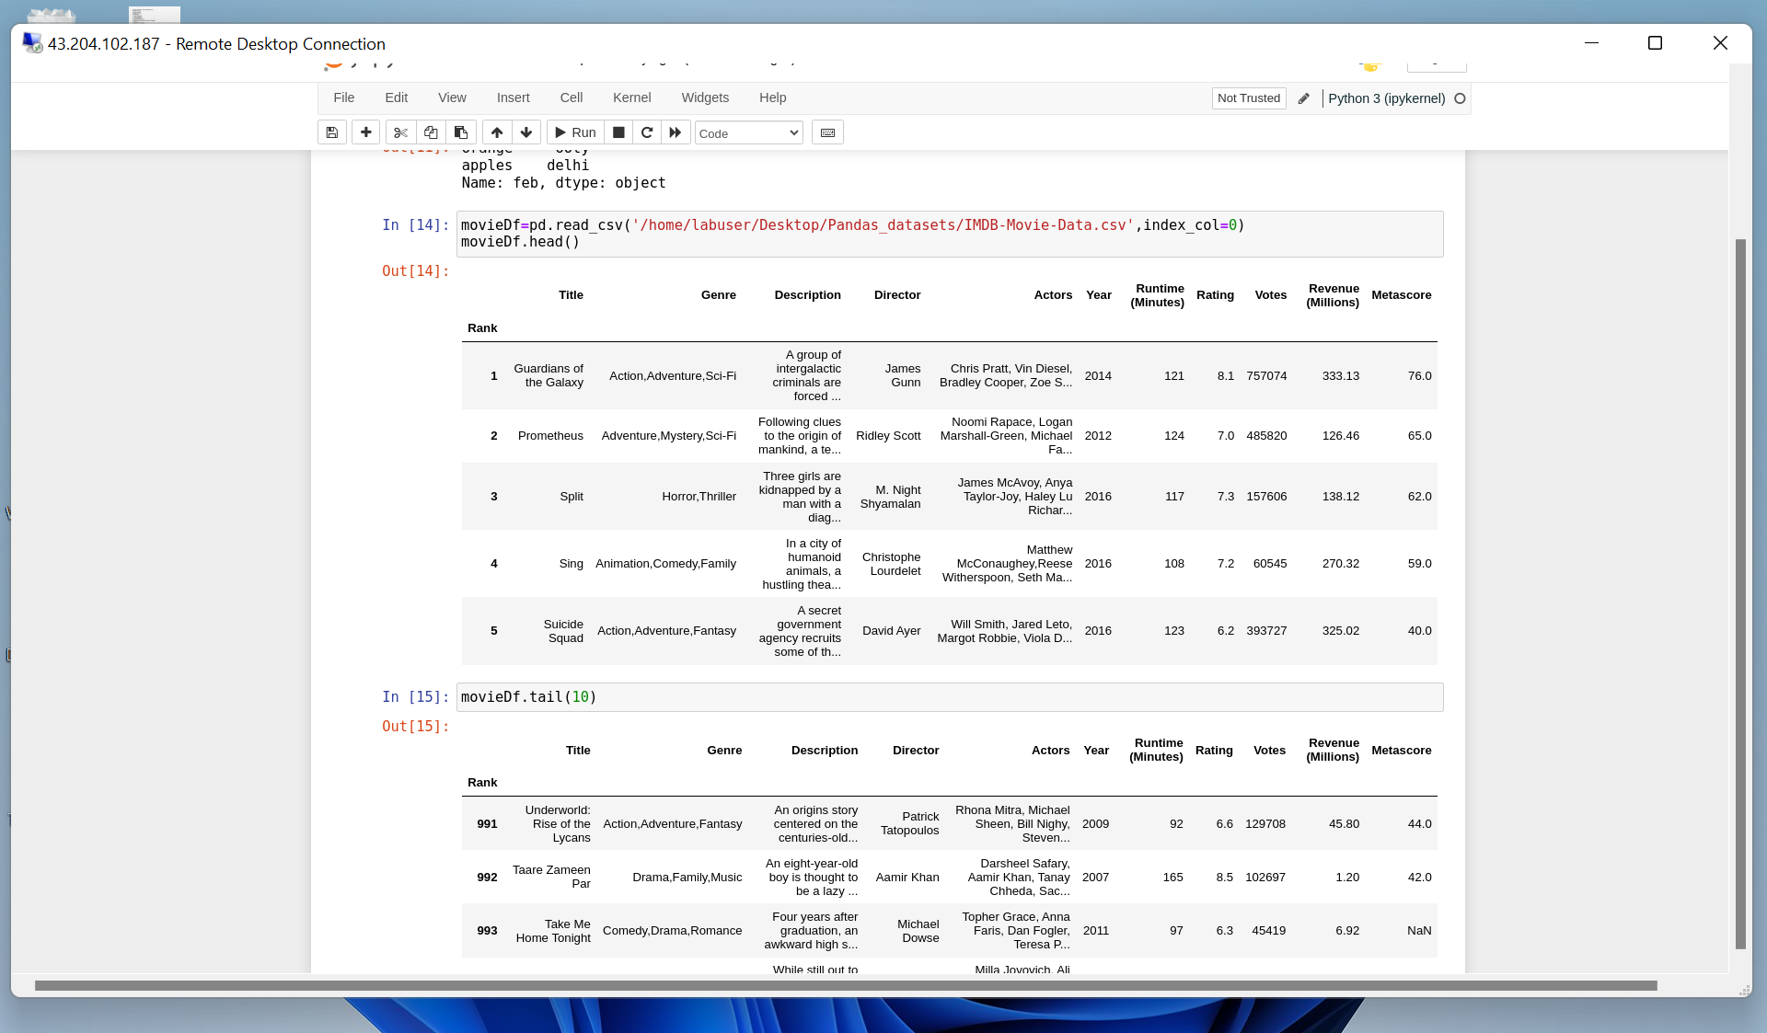
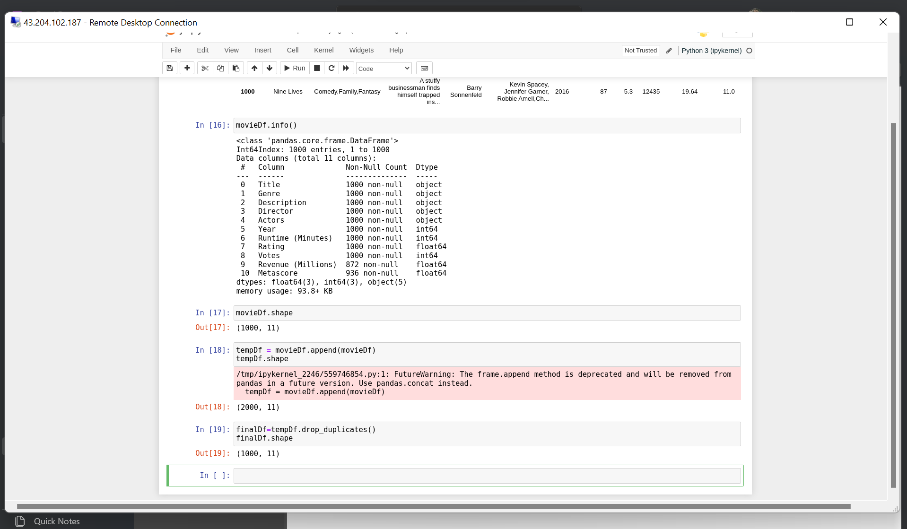
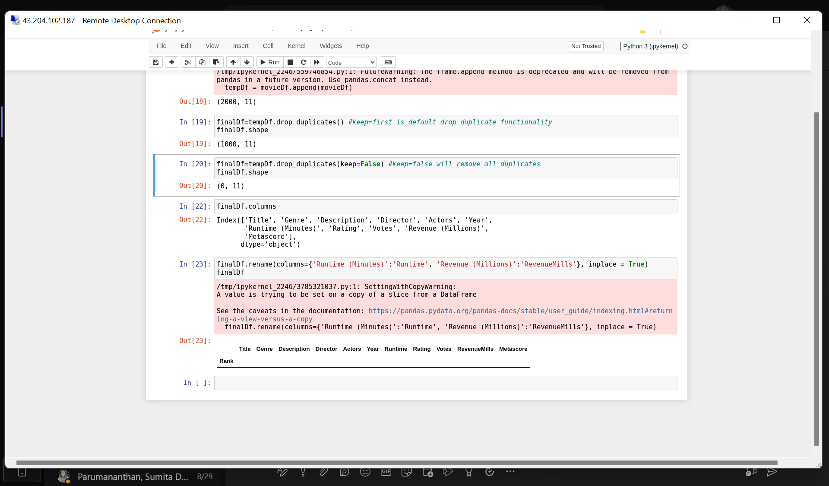
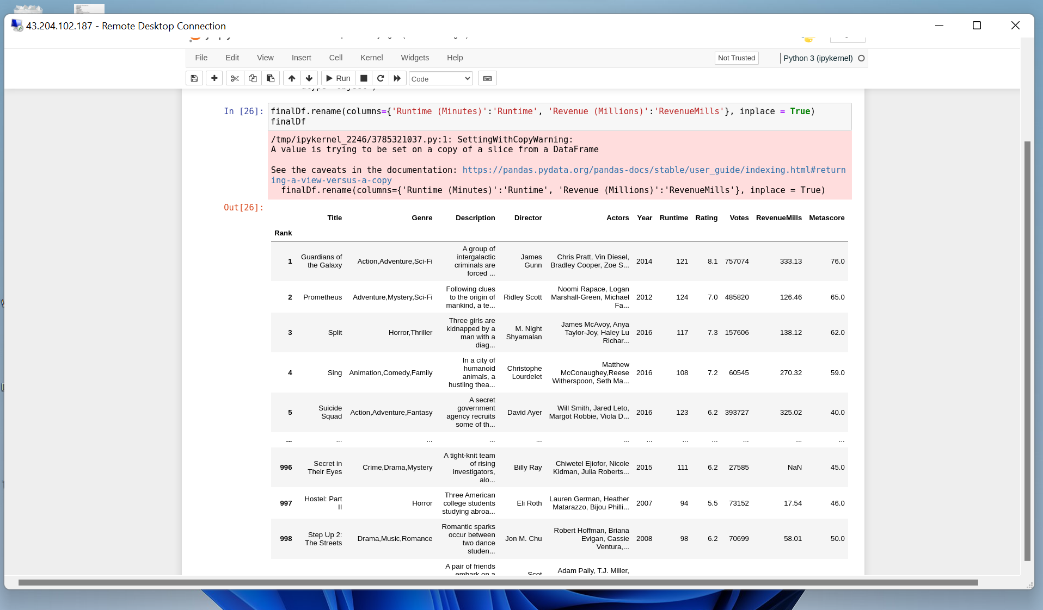
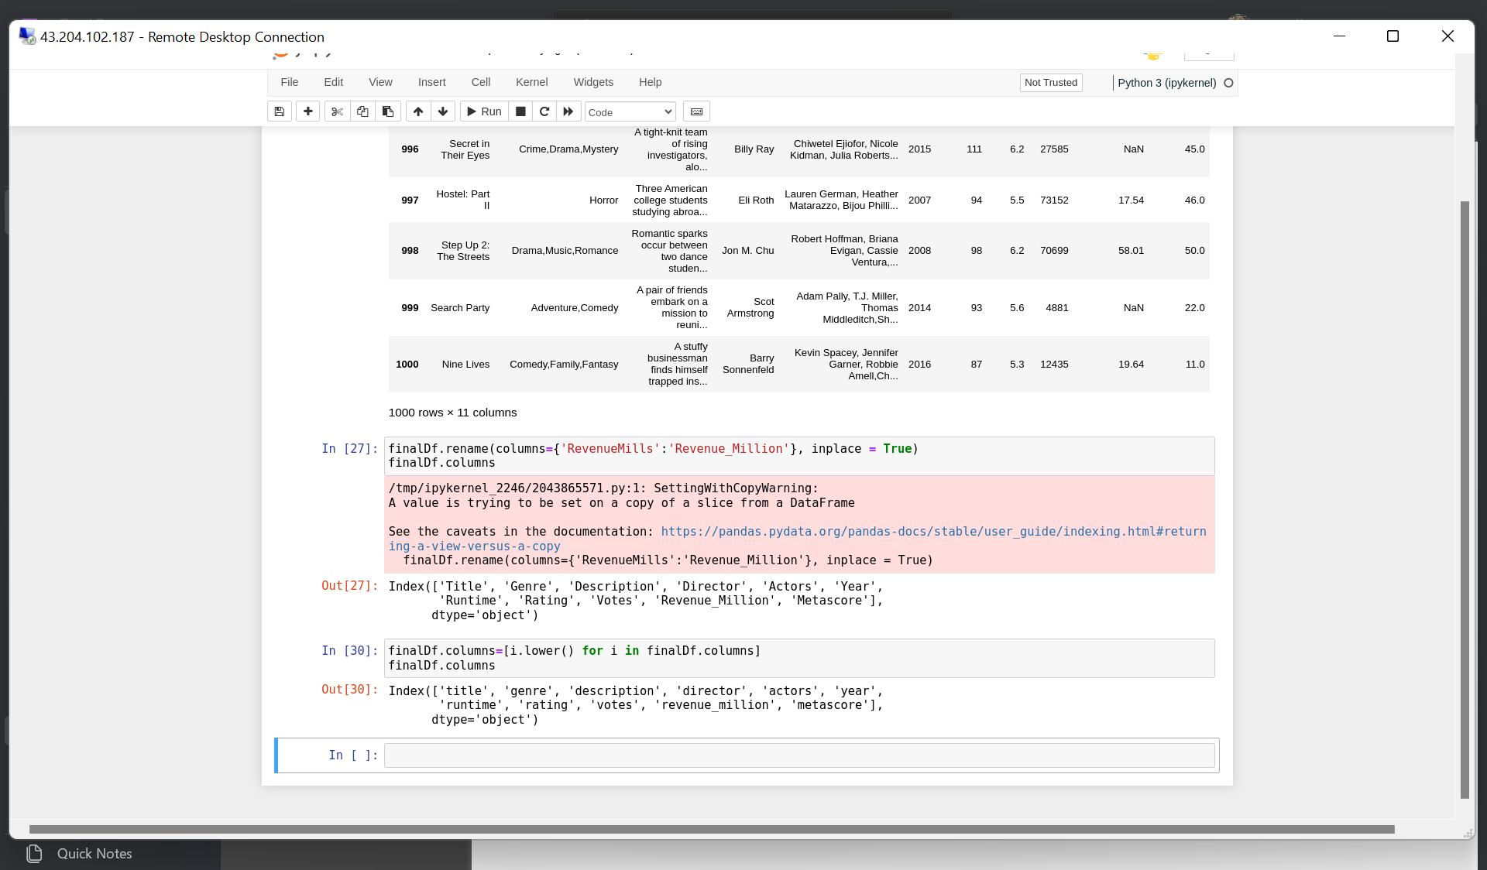
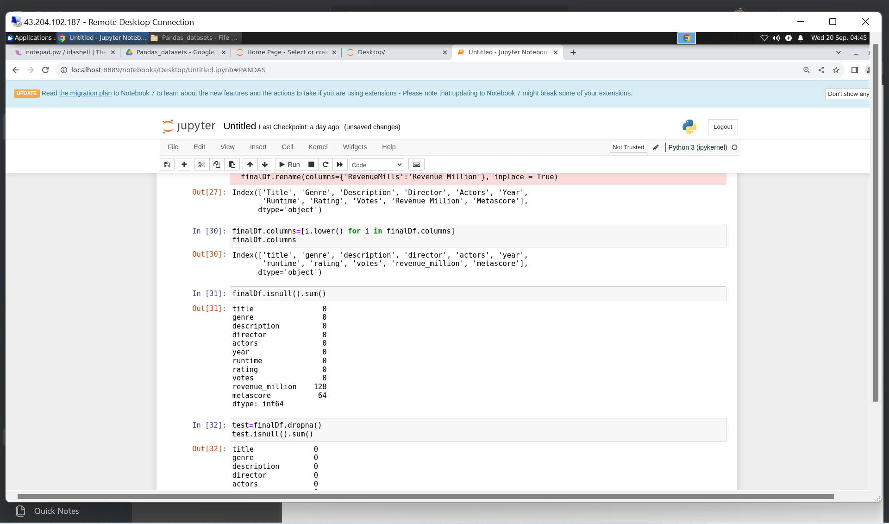
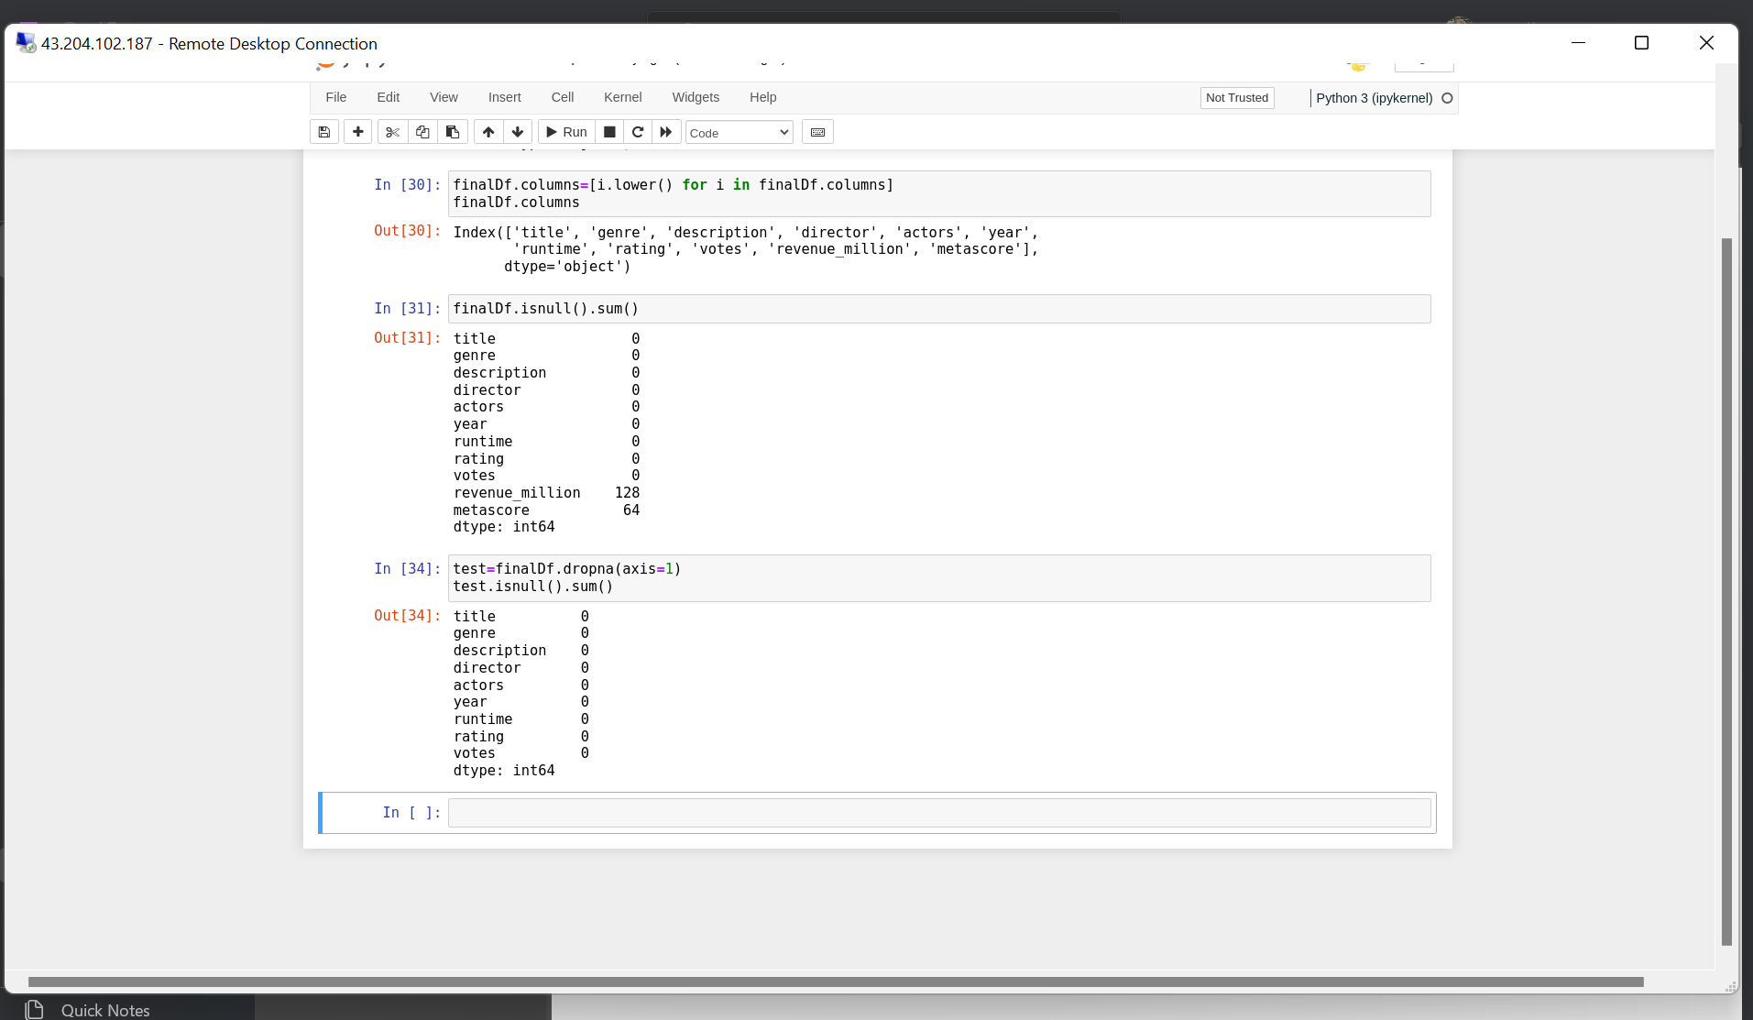
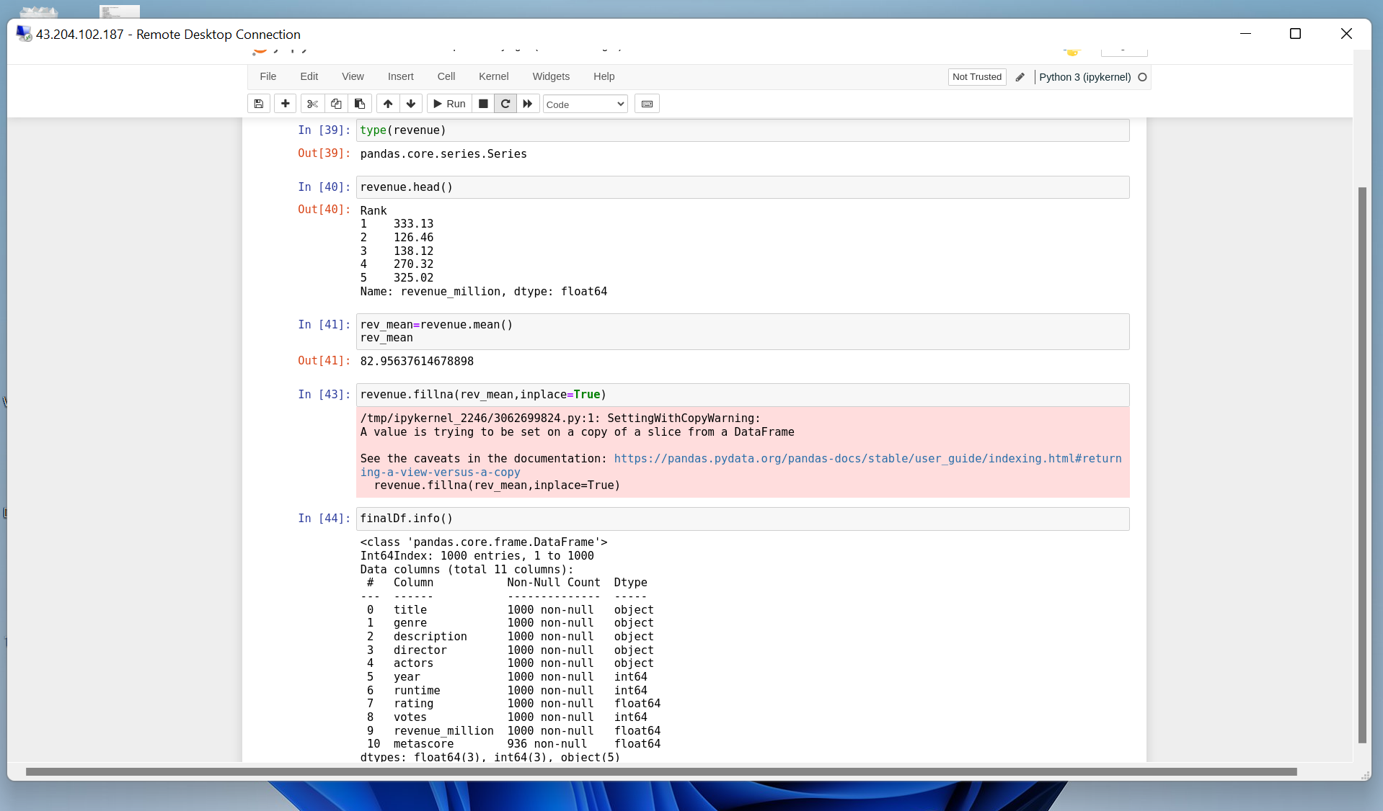

Slide 6
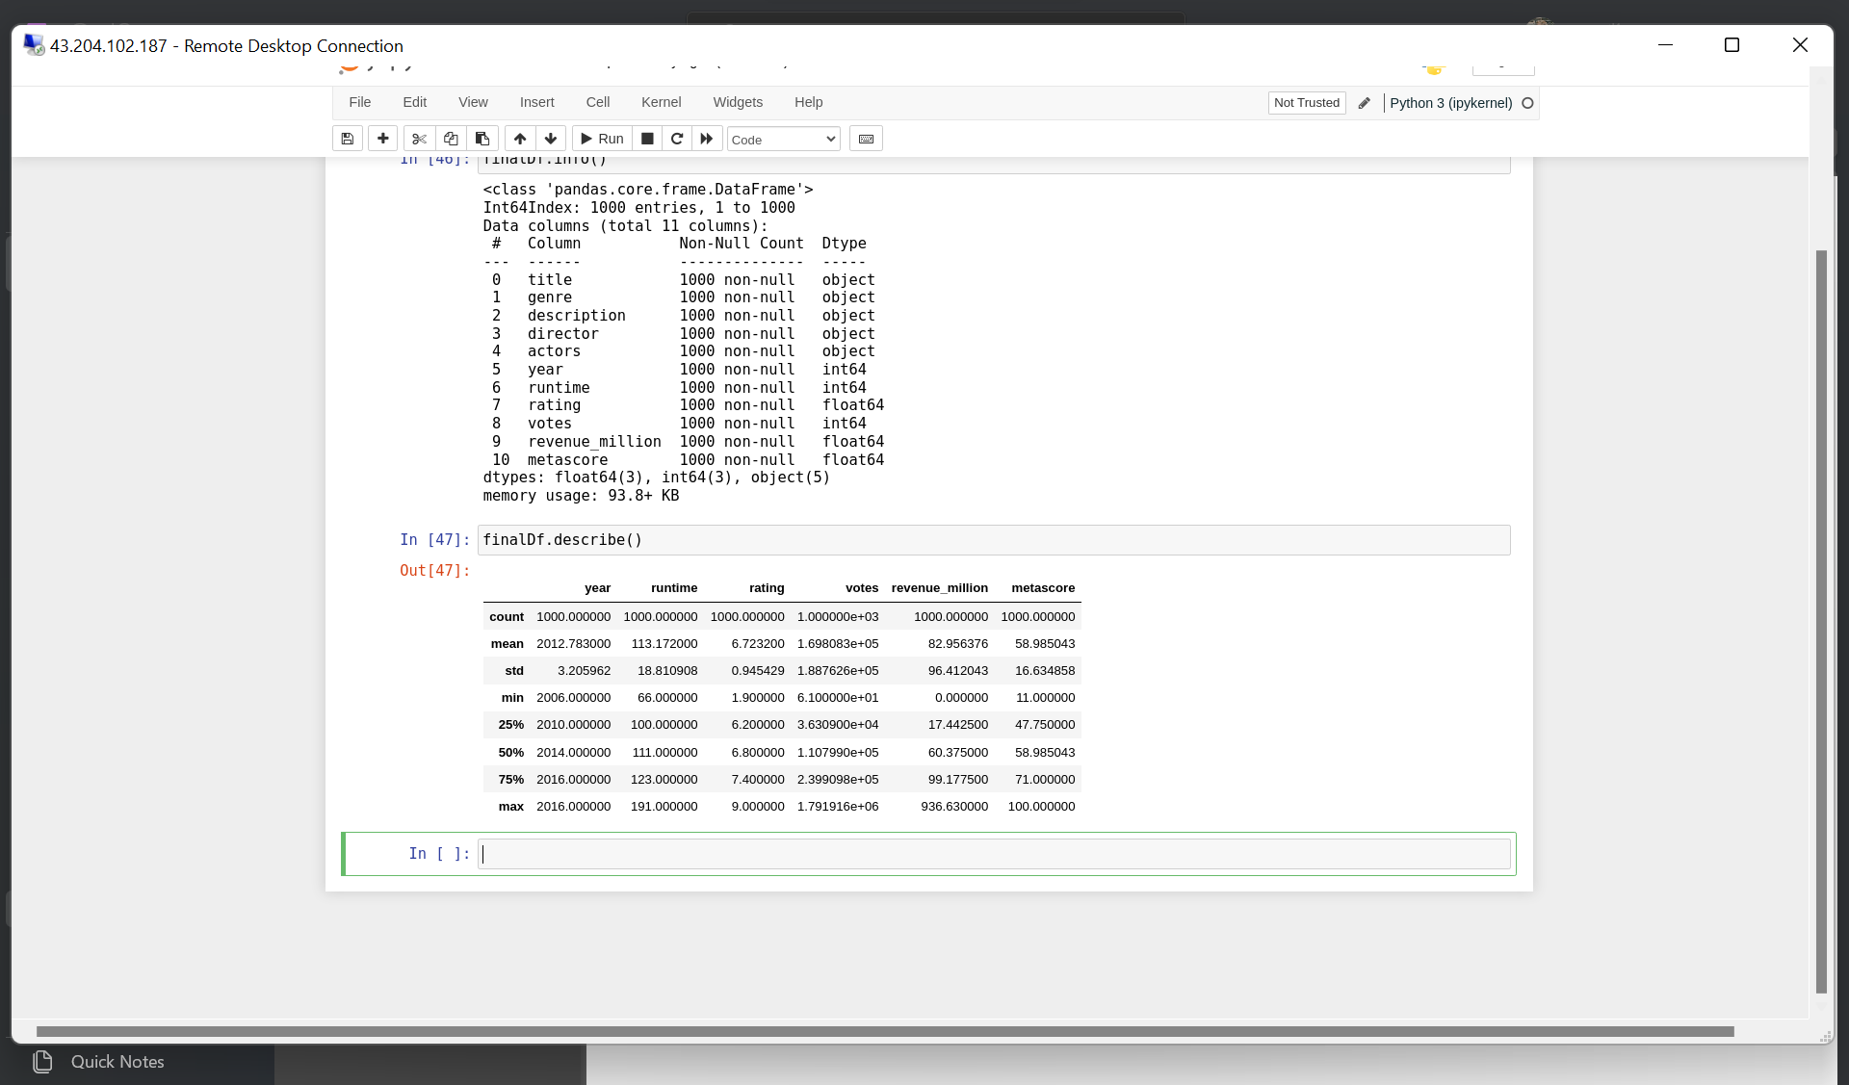
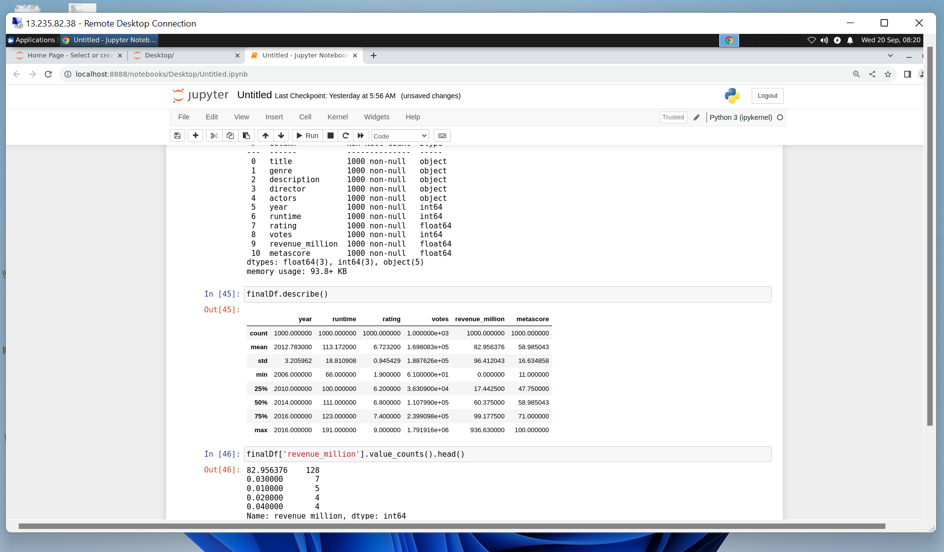
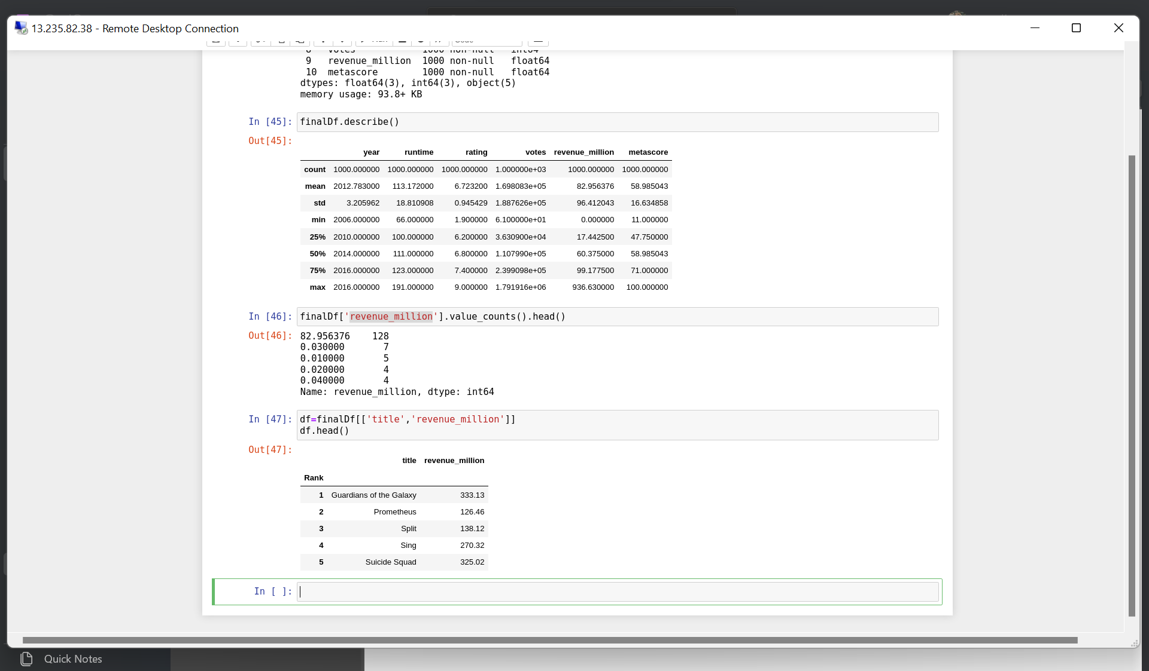
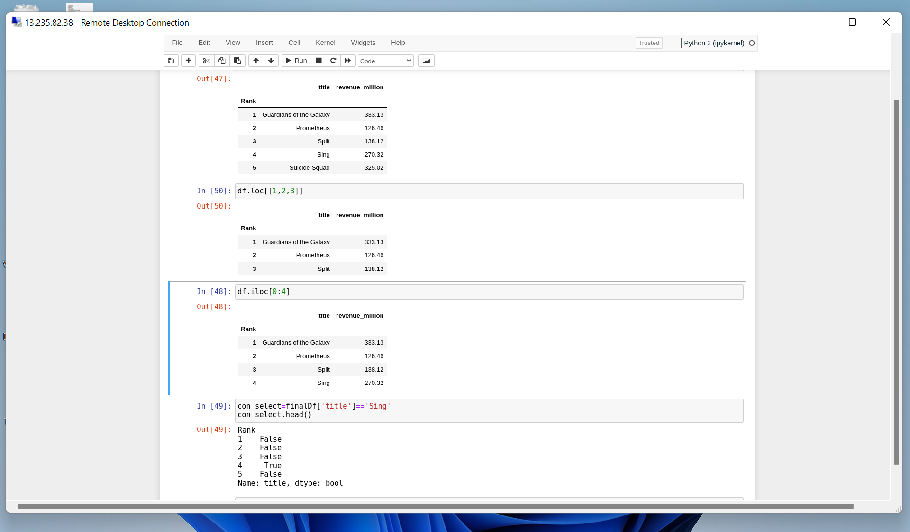
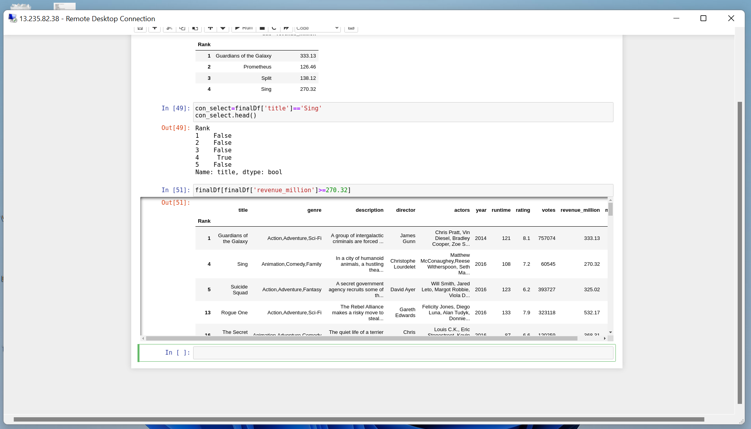
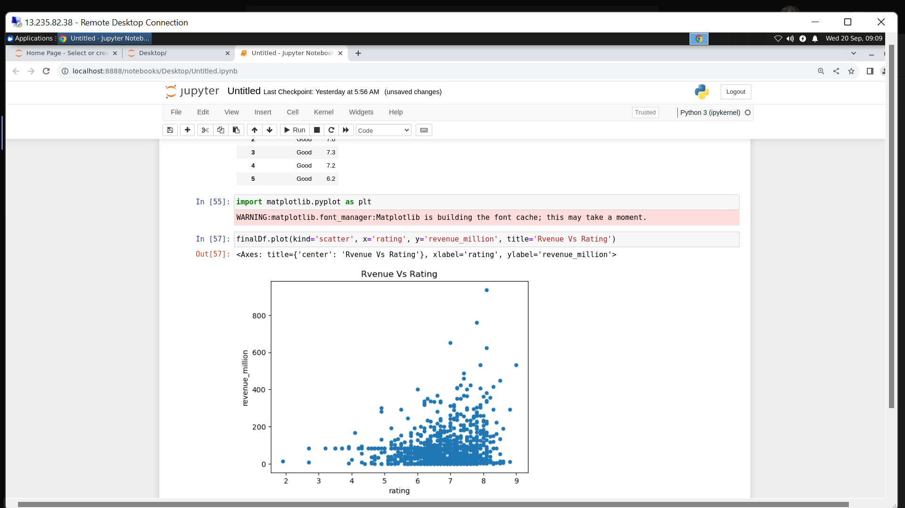

Slide 7
DAY-3
Driver process
Executors
Cluster Manager
Partition
Job, Stage and Task
Lazy Evaluation
RDD (Resilient Distributed Dataset)
Caching
Catalyst and Tungsten
RDD vs Dataframe
Deployment Types
Client Mode
Cluster Mode
Apache PySpark – Day 1

Slide 8
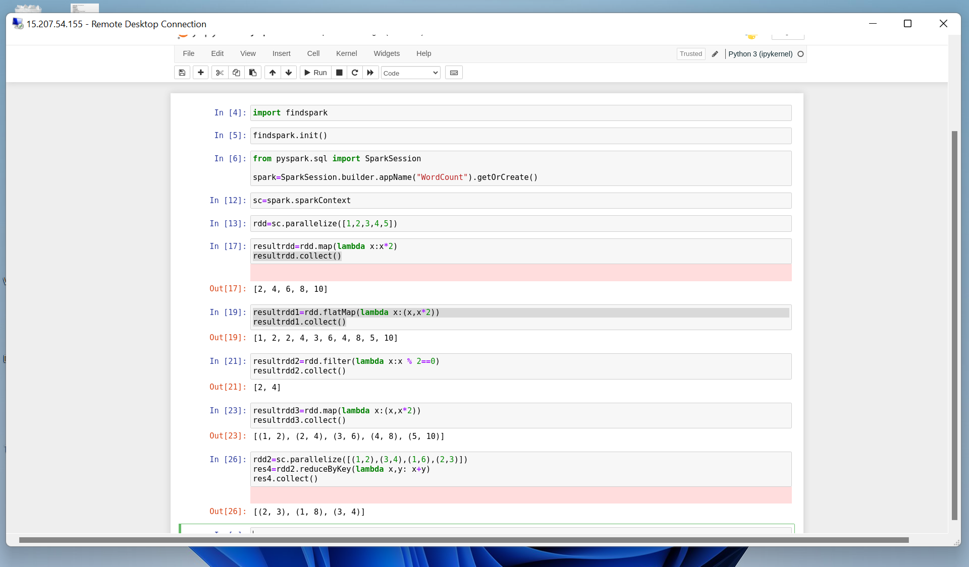
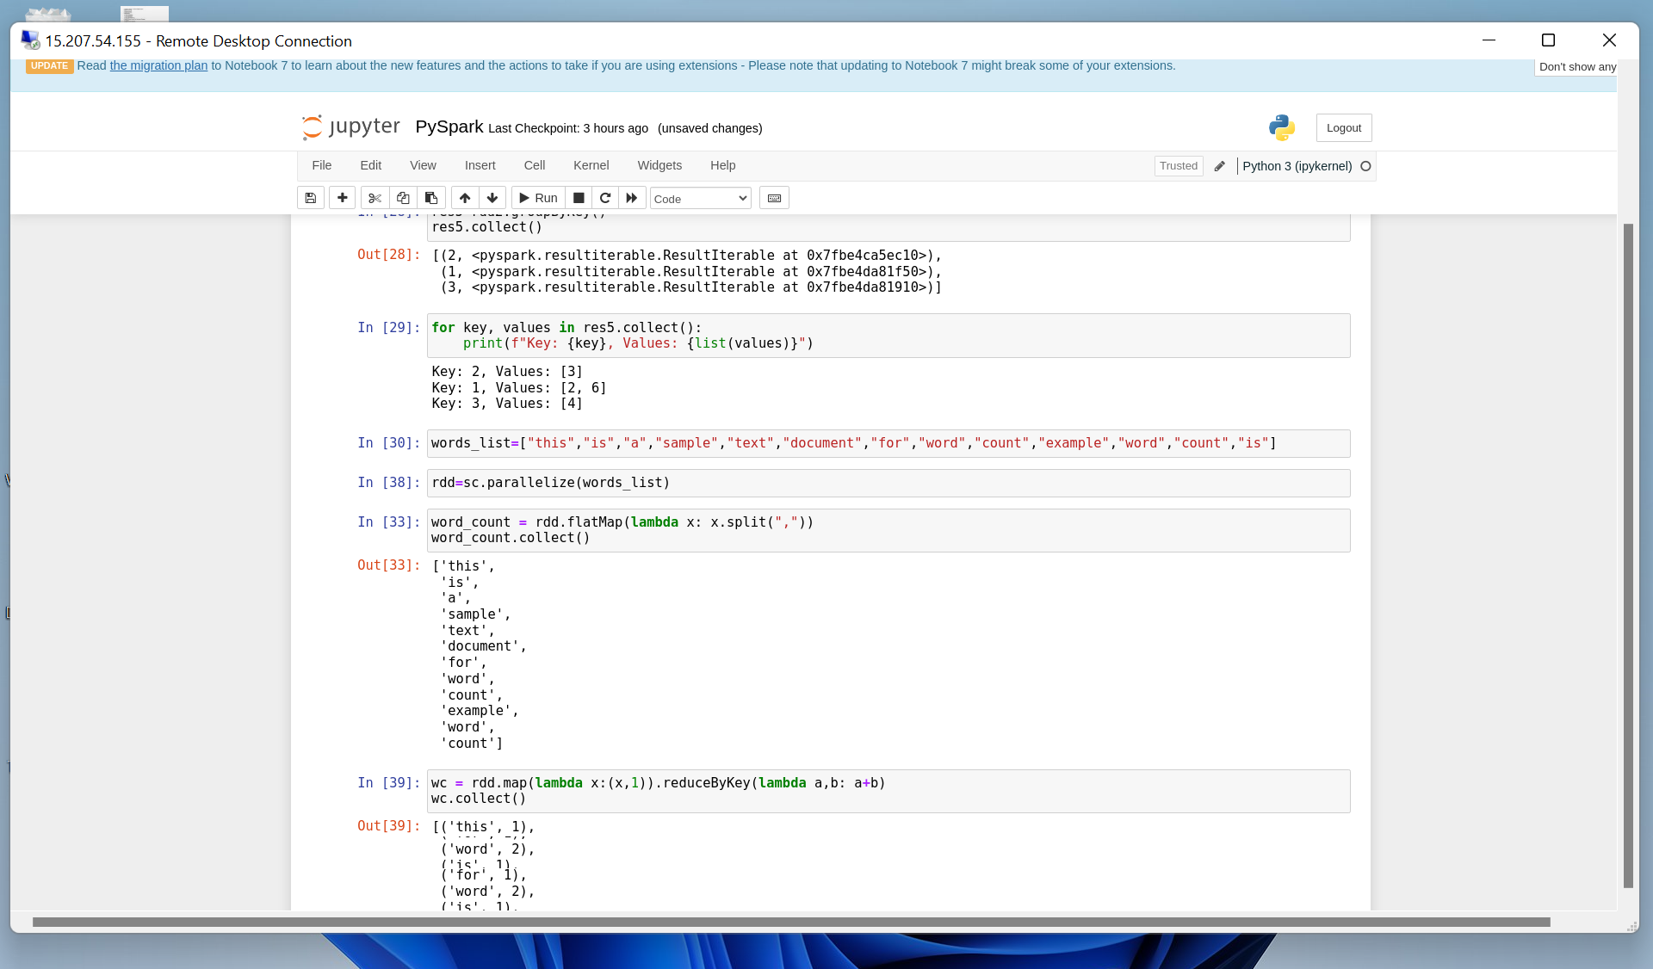
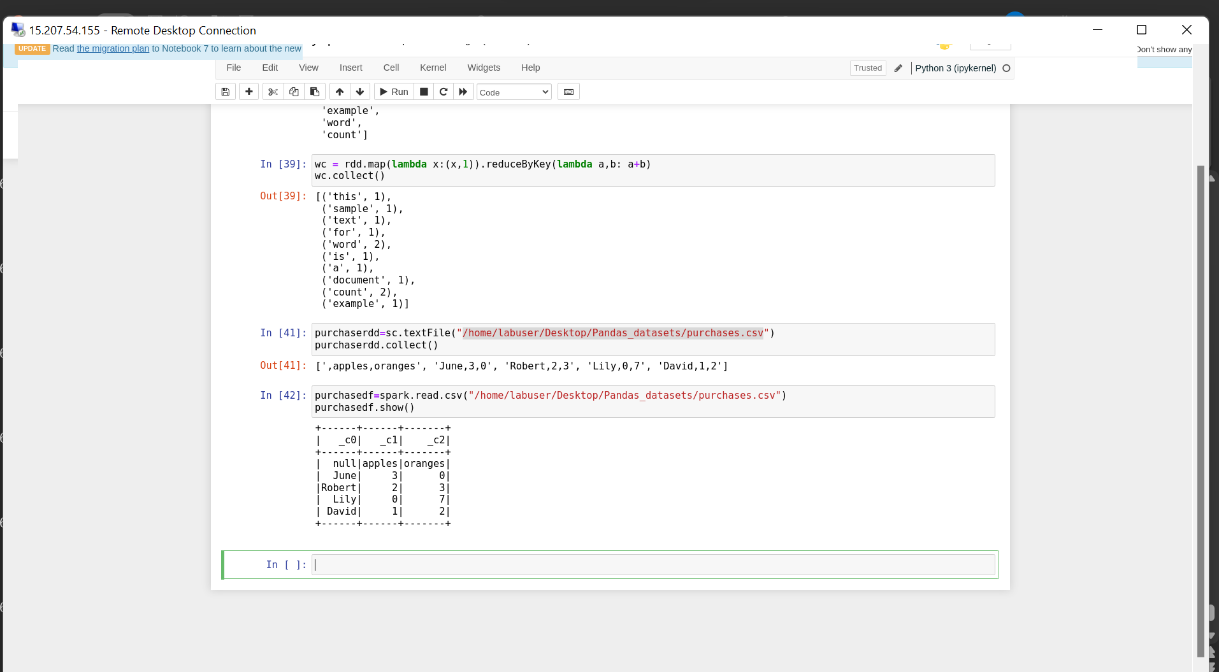
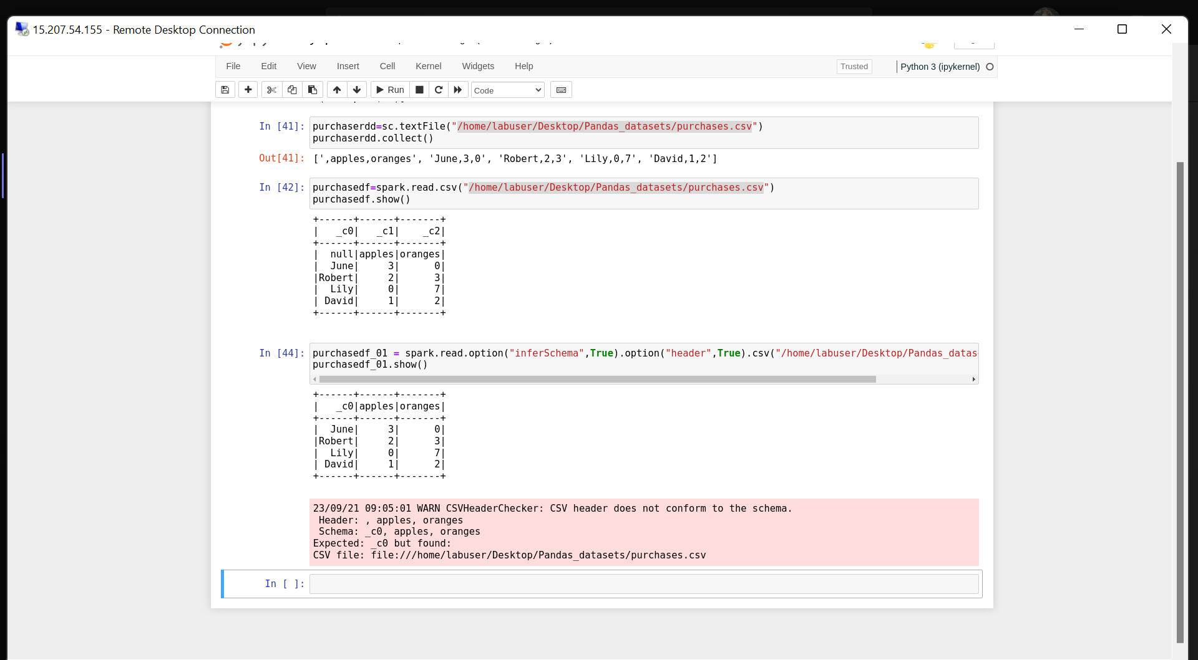

Slide 9
DAY-4
Partitioning
Spark UI URL
SQL in PySpark
Drop duplicates
When – Otherwise condition
Concat and Functions
Caching
Joins
Group By
Apache PySpark – Day 2

Slide 10
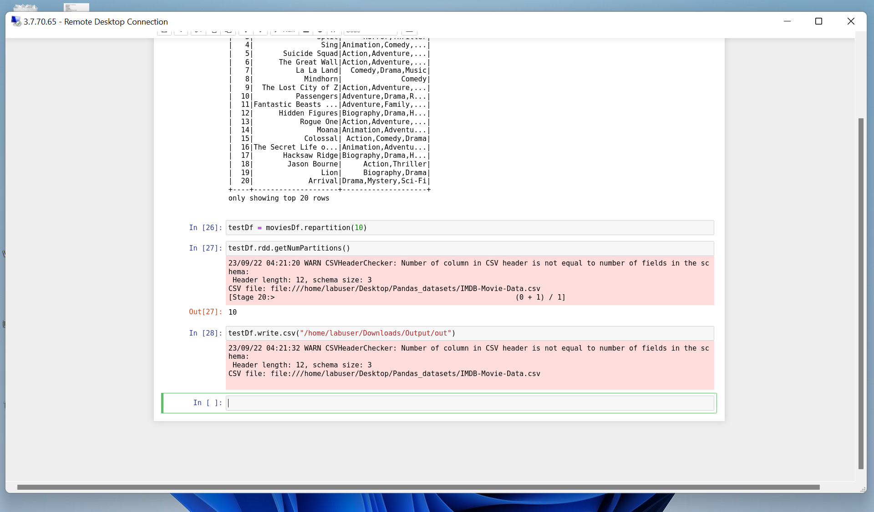
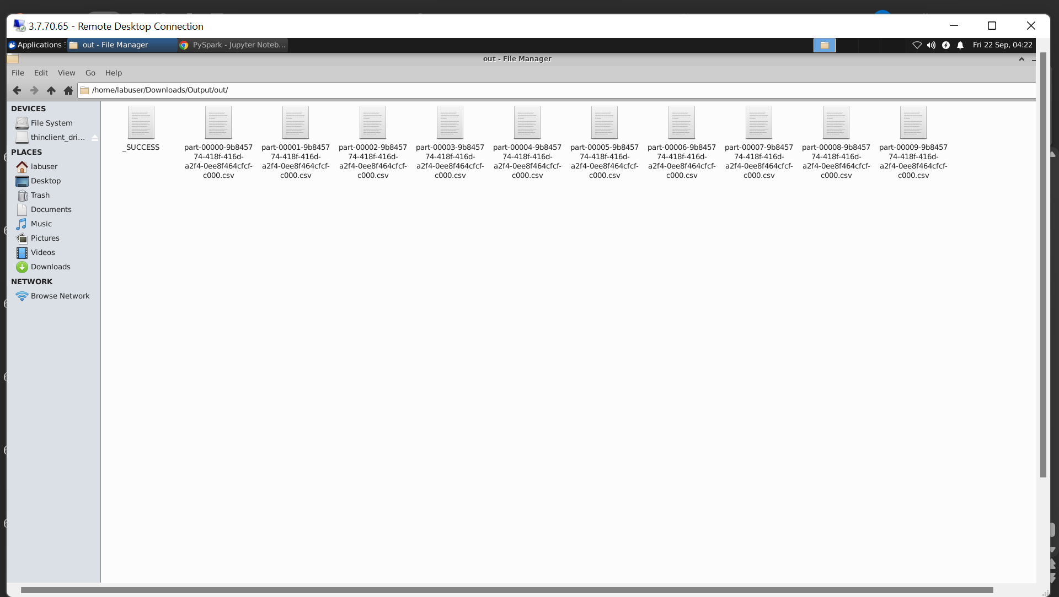
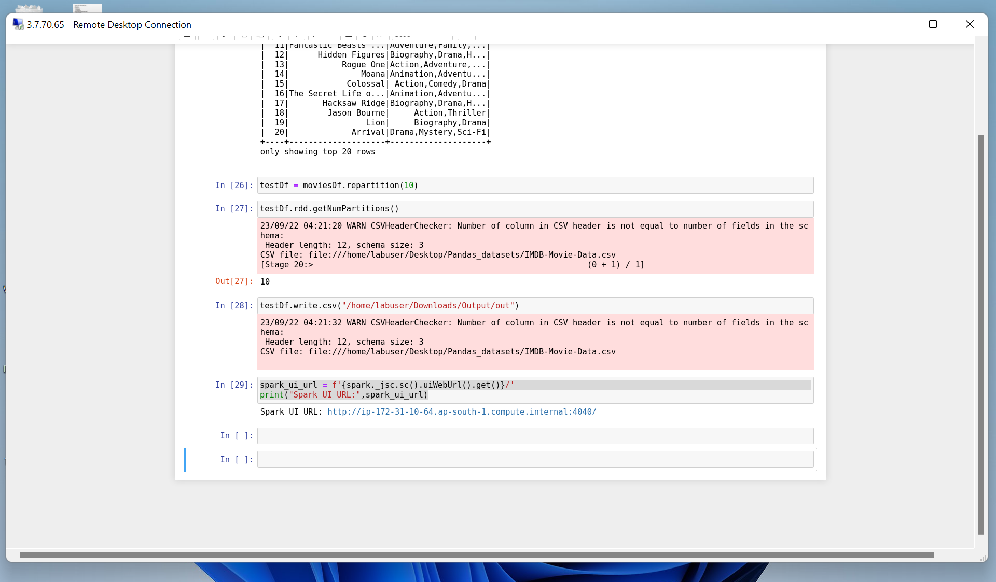
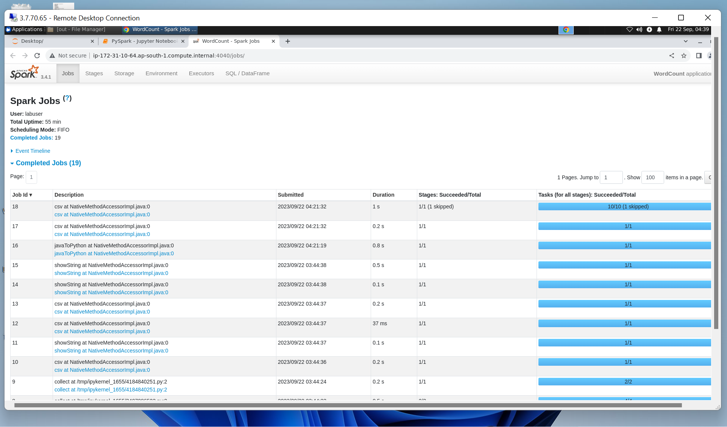
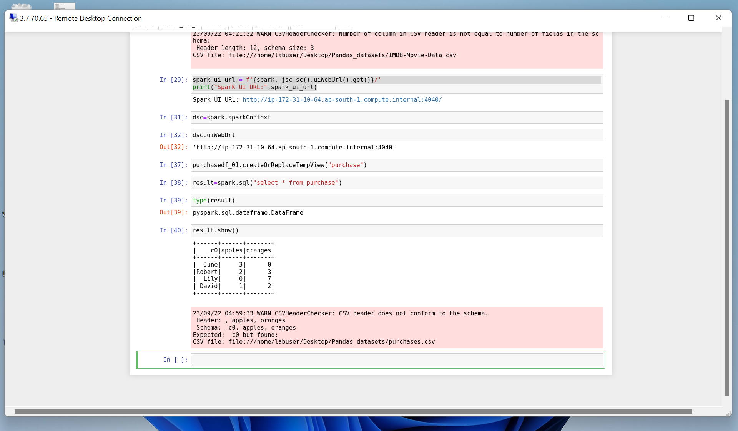
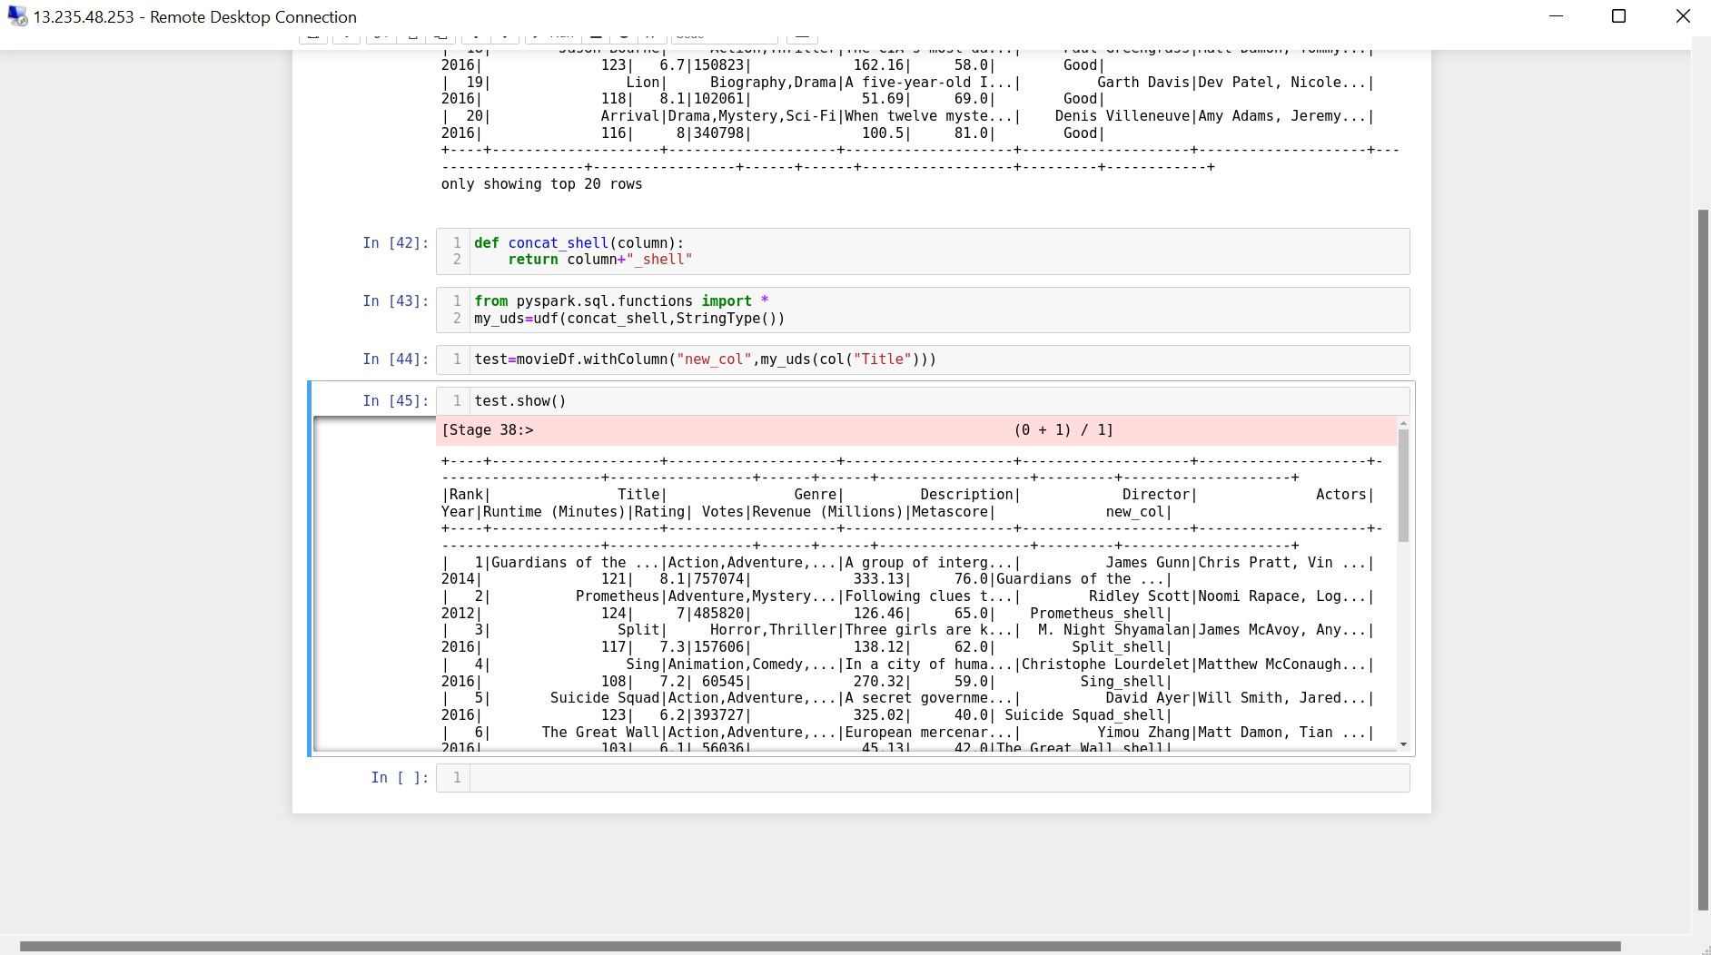
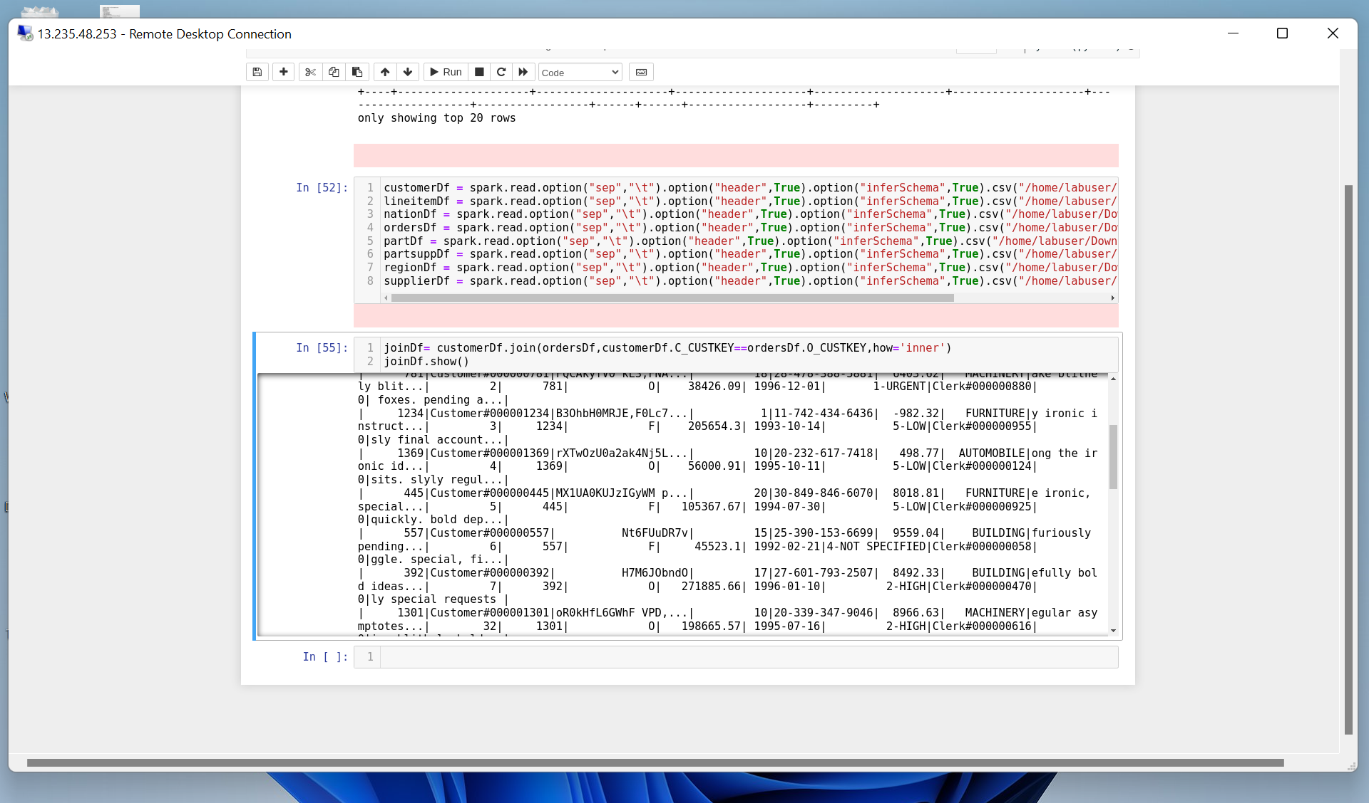
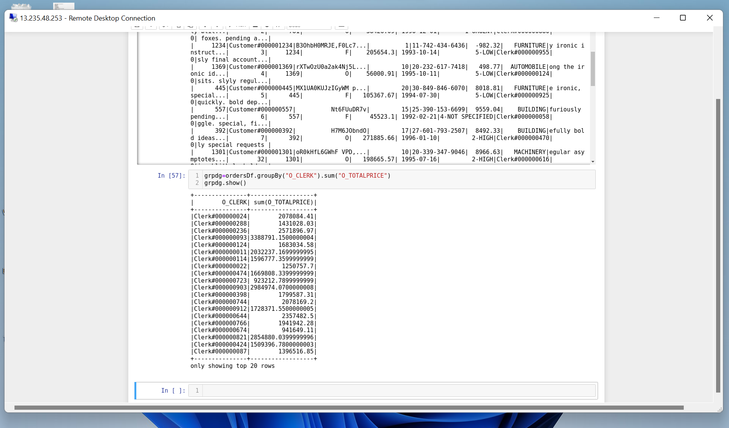

Slide 11
JOURNEY SCRAPBOOK
Custom Bootcamp (29th August – 6th October)
Week-5
Radhika Tibrewal

Slide 12
DAY-1
Caching
Persist and different storage levels
Aggregation
Managed and External Tables
Partitioning
For-Each
Apache PySpark – Day 3
** Note : Only 4 hours training due to OneIDA event. **

Slide 13
DAY-2
What is databricks?
Setting Up azure databricks
Overview of Databricks Workspace
Cluster configuration
Mounting
Widgets
Parameters
Functions
%run, %md, %language
Structured streaming
Azure Databricks – Day 1

Slide 14
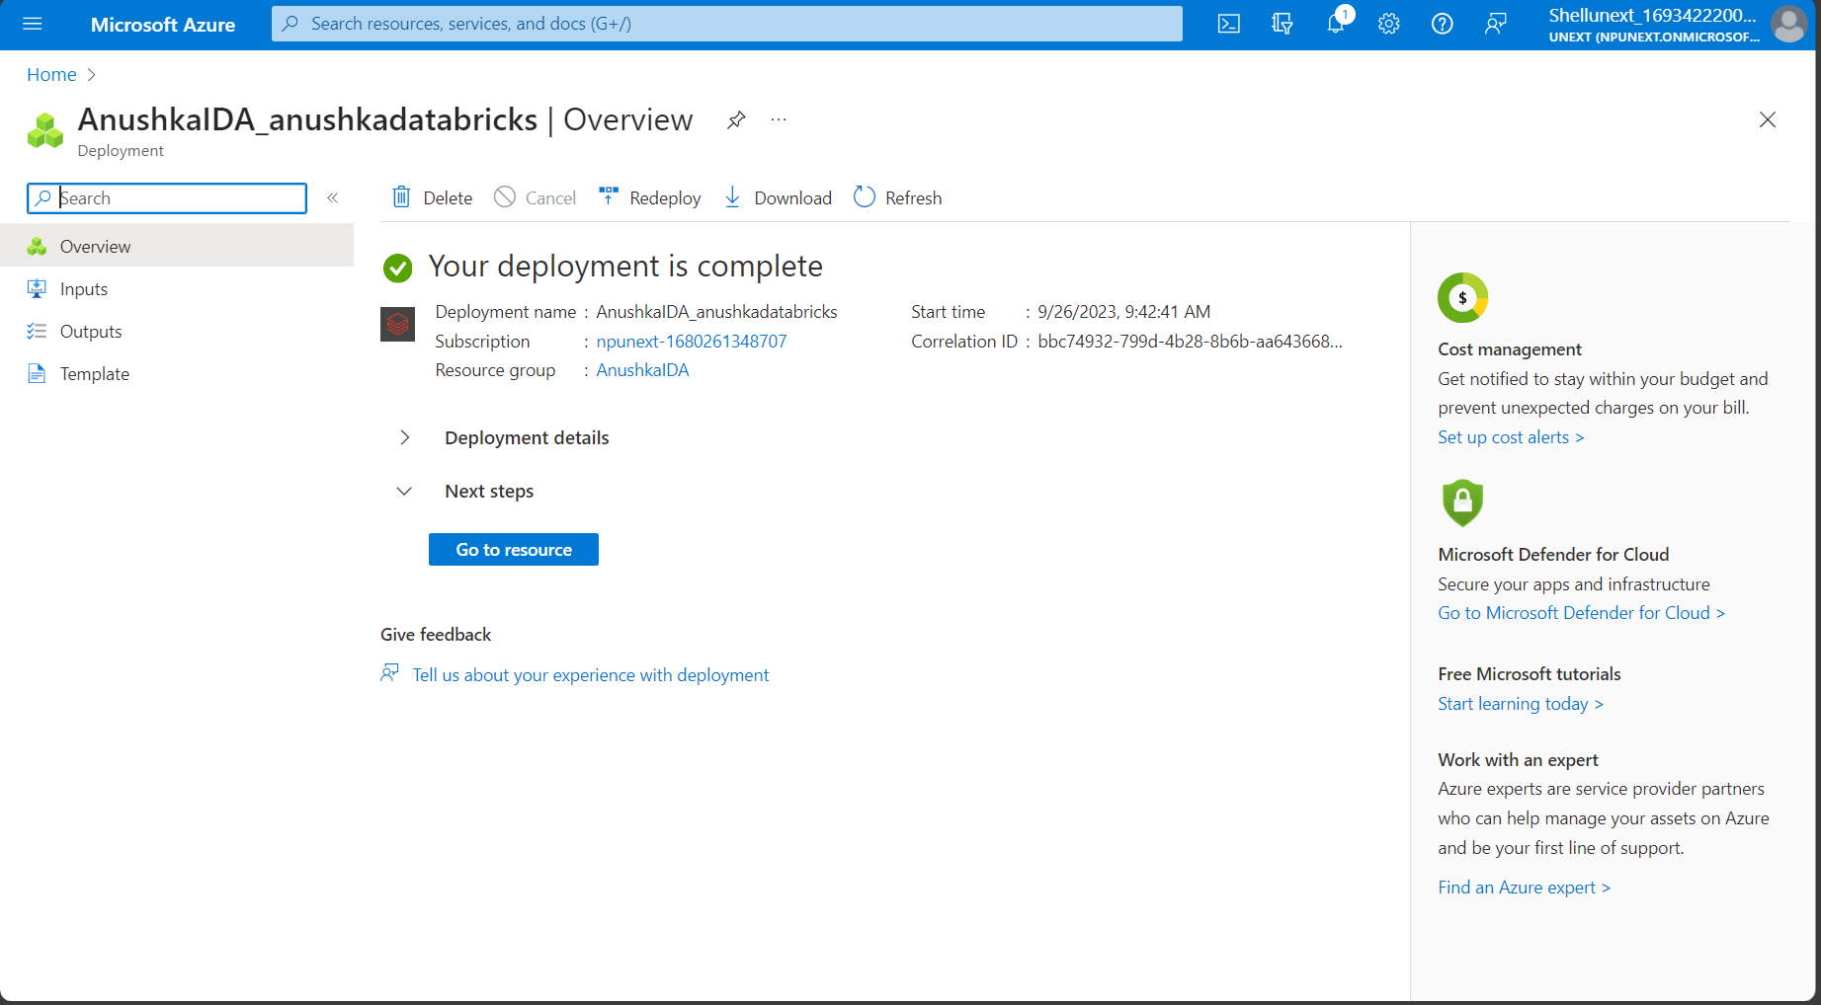
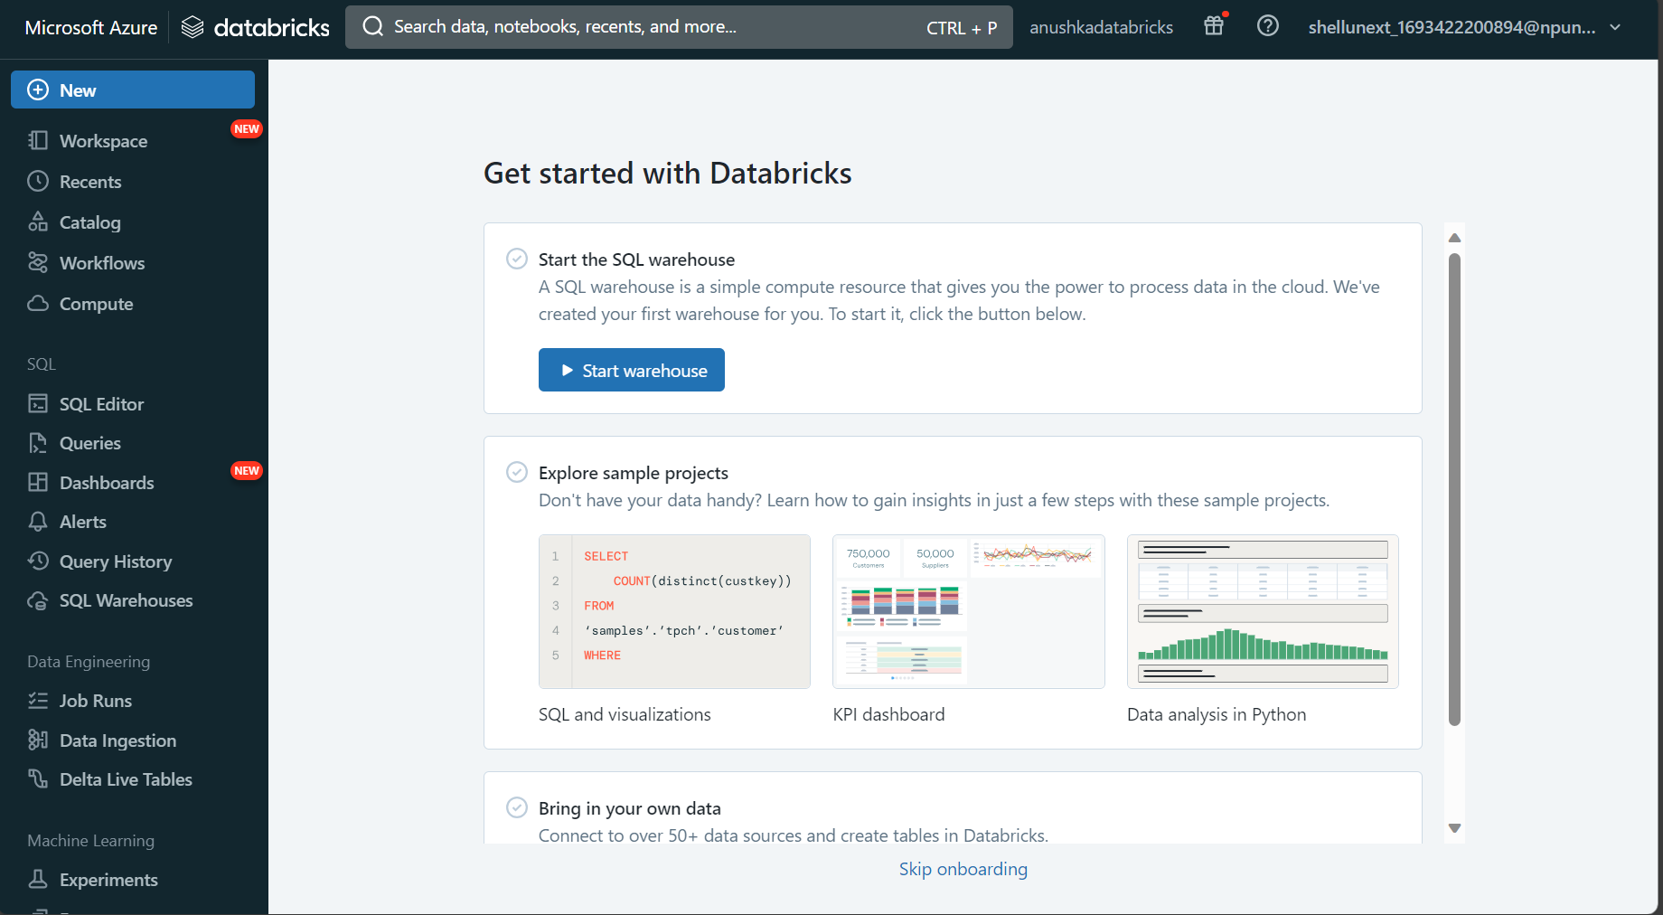
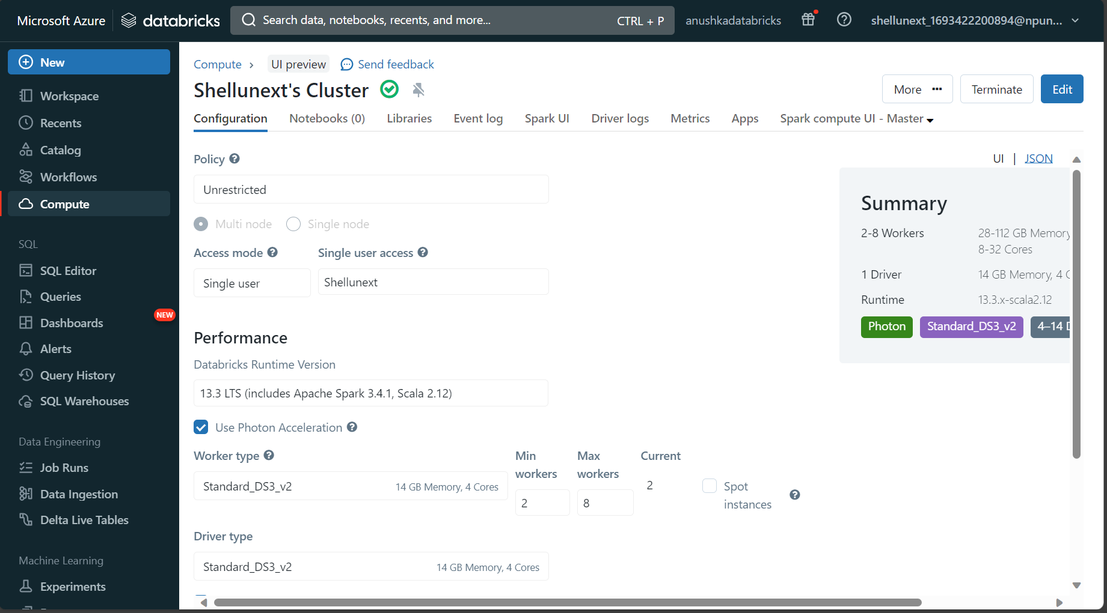
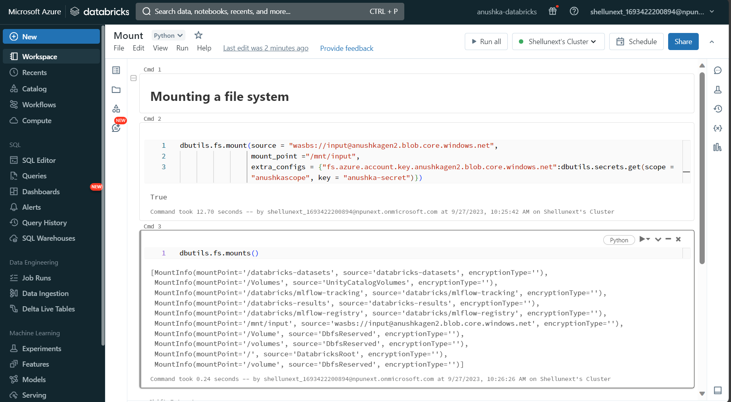

Slide 15
DAY-3
Structured streaming
DBFS from sample data
Delta table & Parquet table
Partition Tables
Medallion / Multi hop Architecture
Workflows → Jobs
Accessing data from Azure SQL database
Unity catalog in databricks
Metastore
Azure Databricks – Day 2

Slide 16
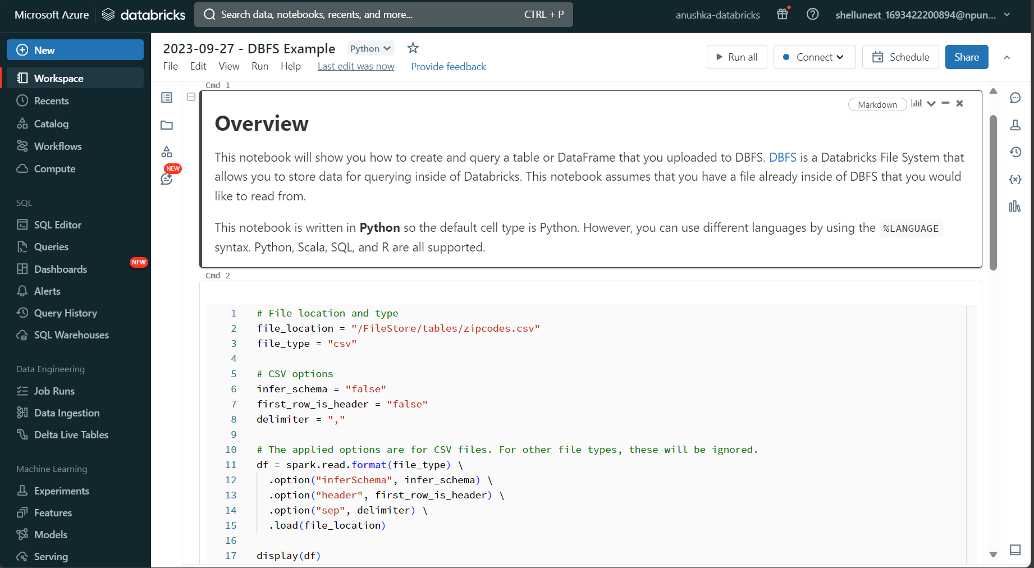
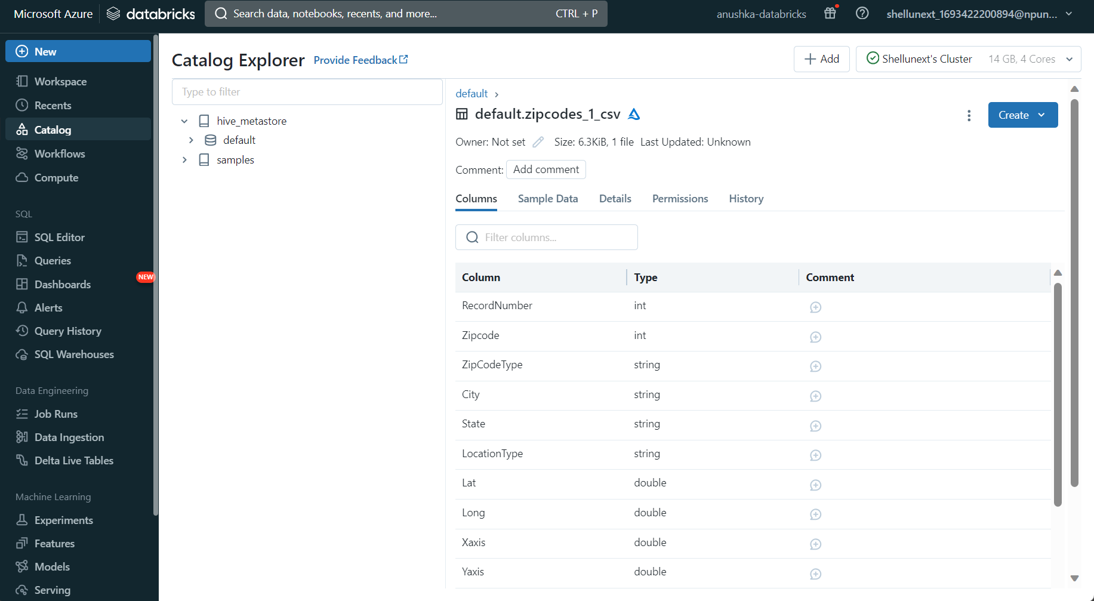
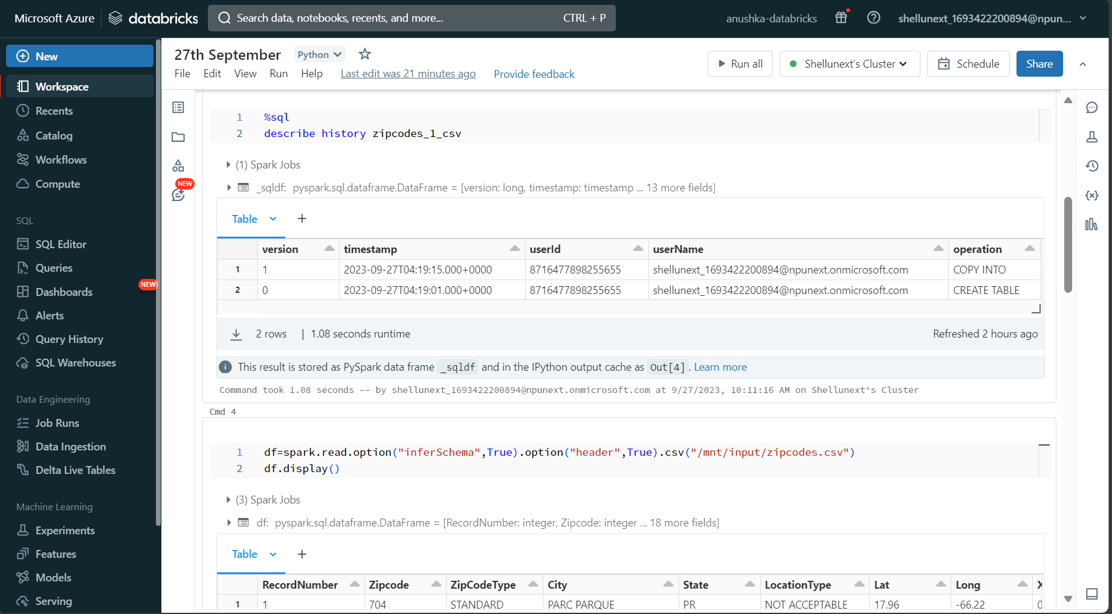
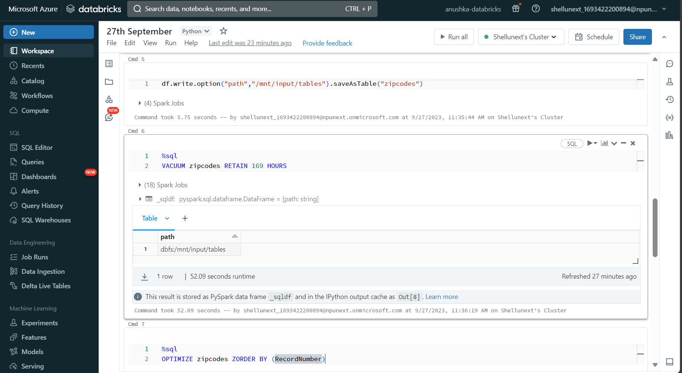
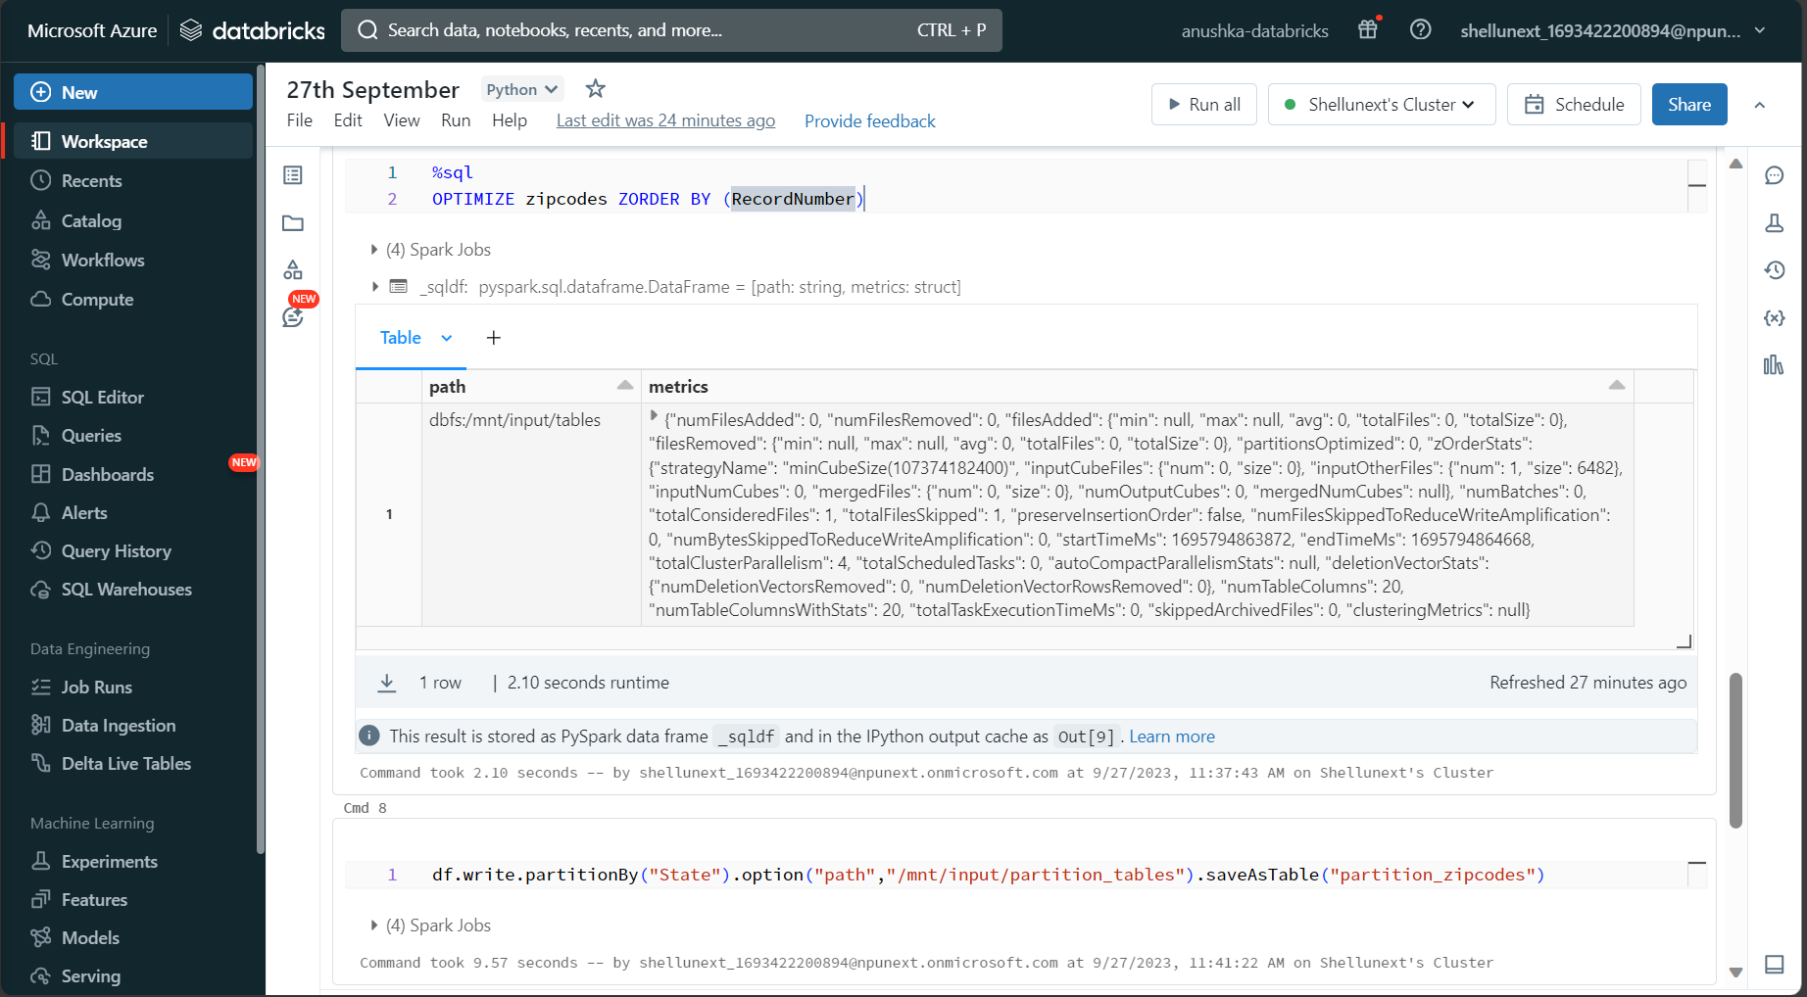
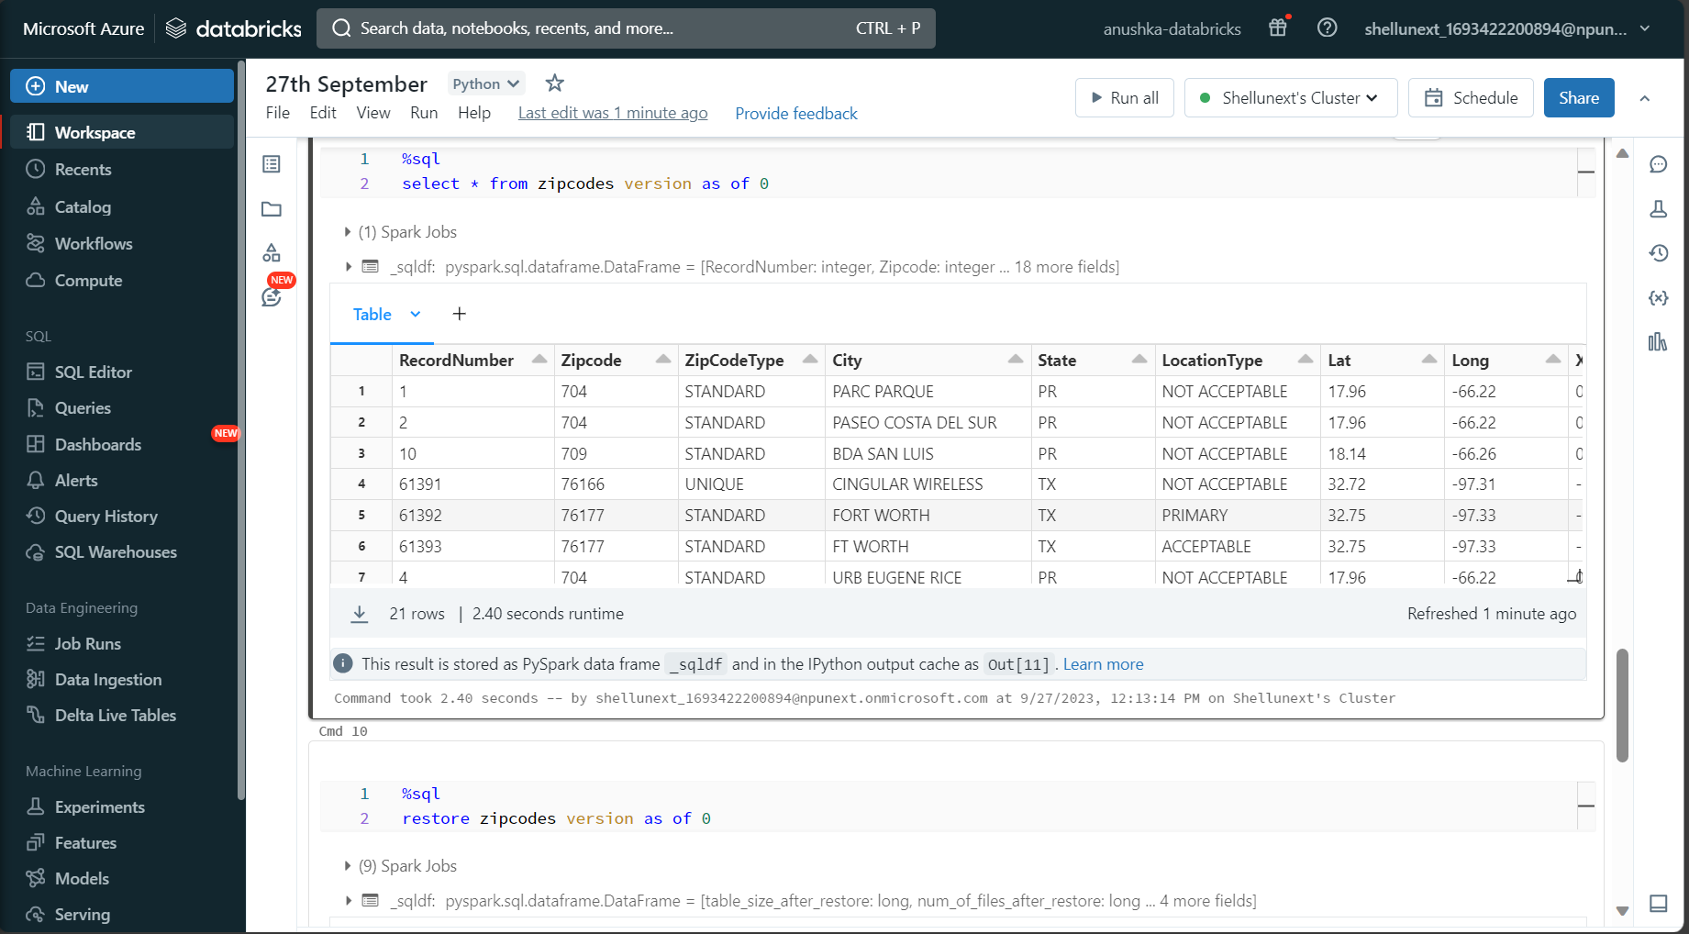
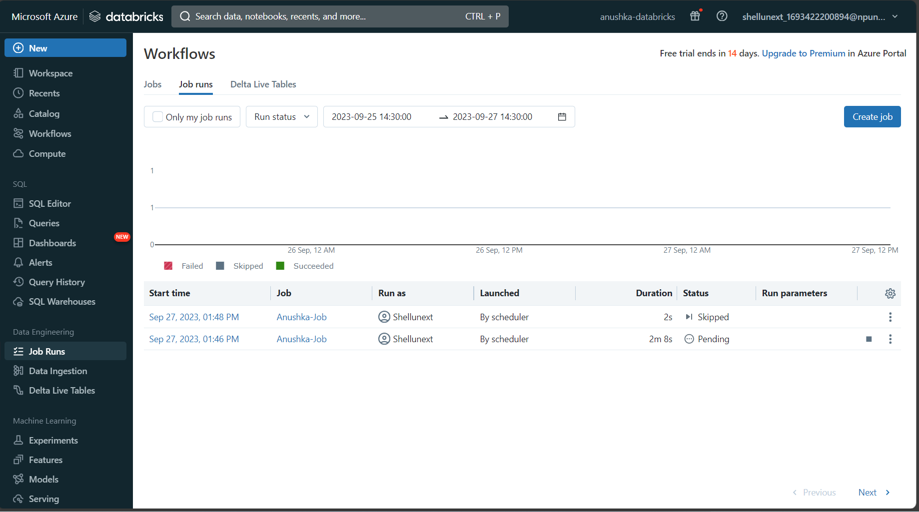
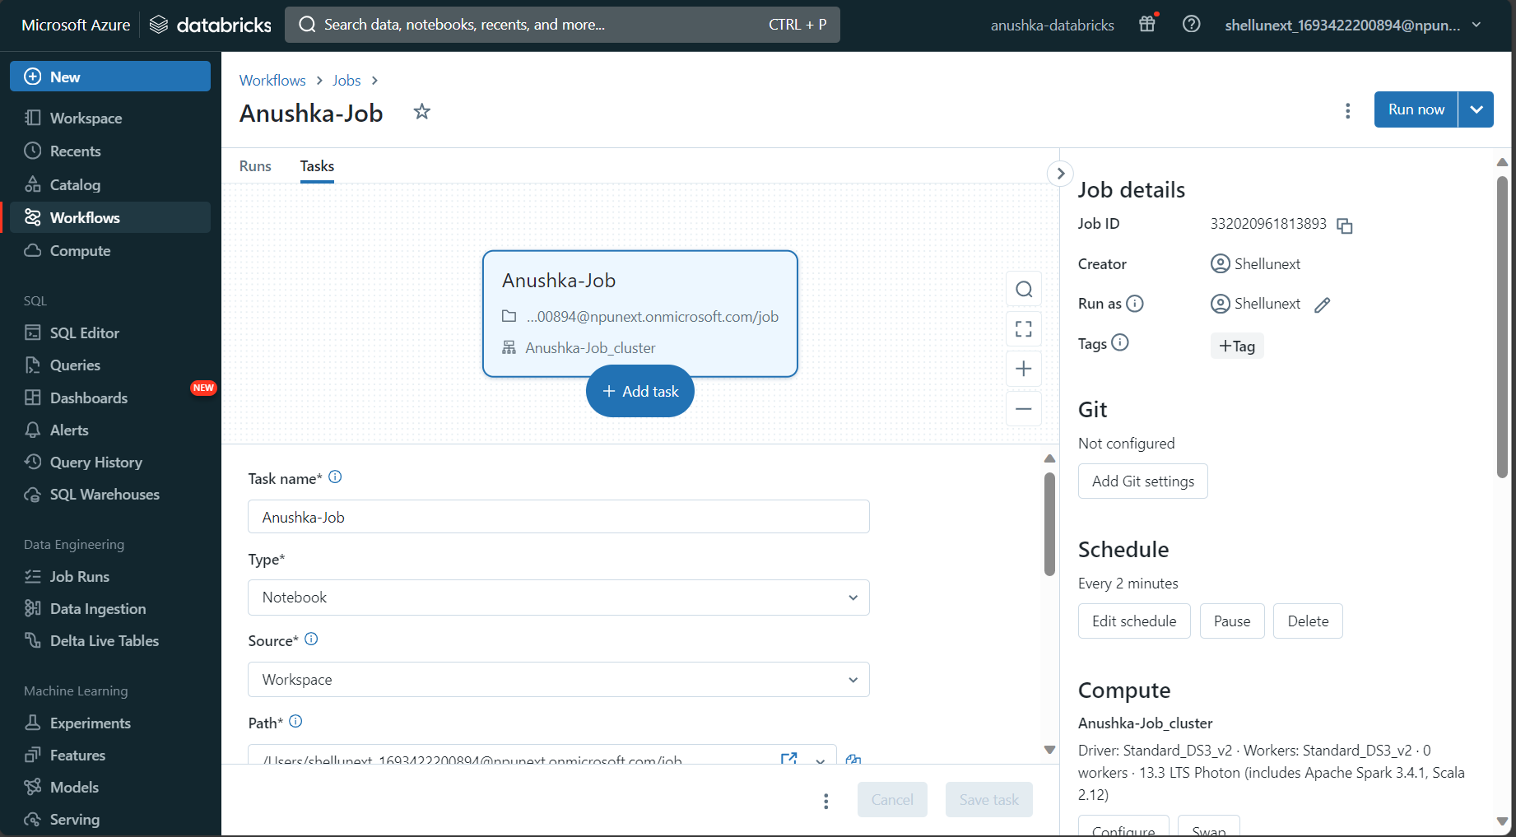

Slide 17
DAY-4
What is Docker ?
Docker initialization in VM
Build Docker image
Application
Requirement.txt
Dockerfile
Image created and Docker push
Azure container registry (ACR)
Kubernetes
AKS
Deploy a single-image application using code and UI
Docker Kubernetes

Slide 18
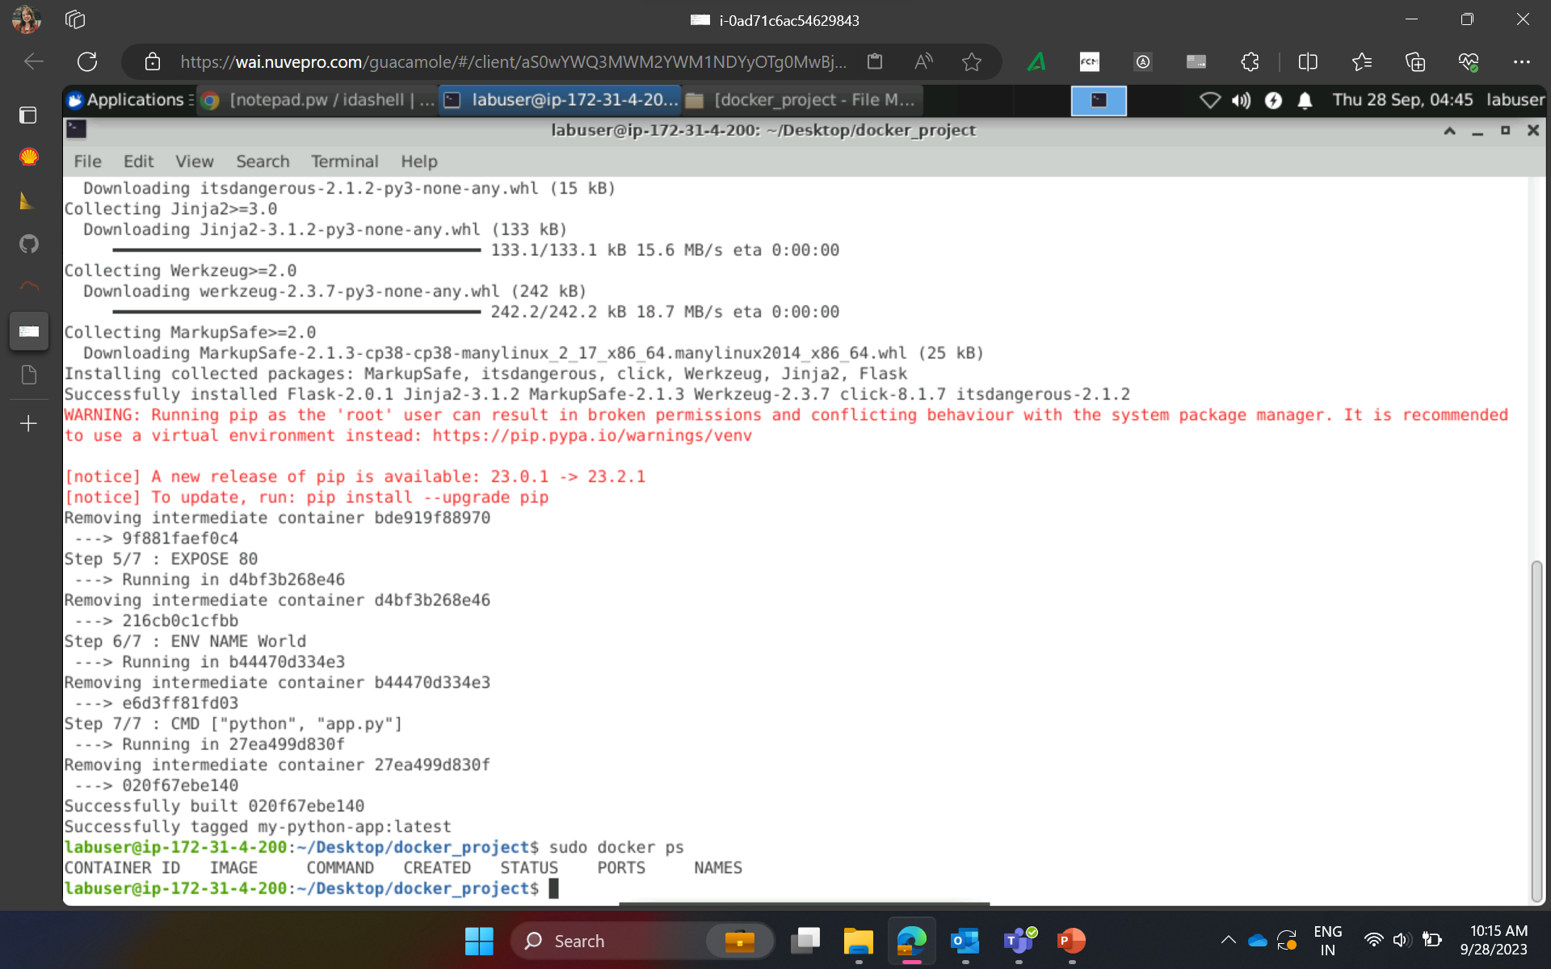
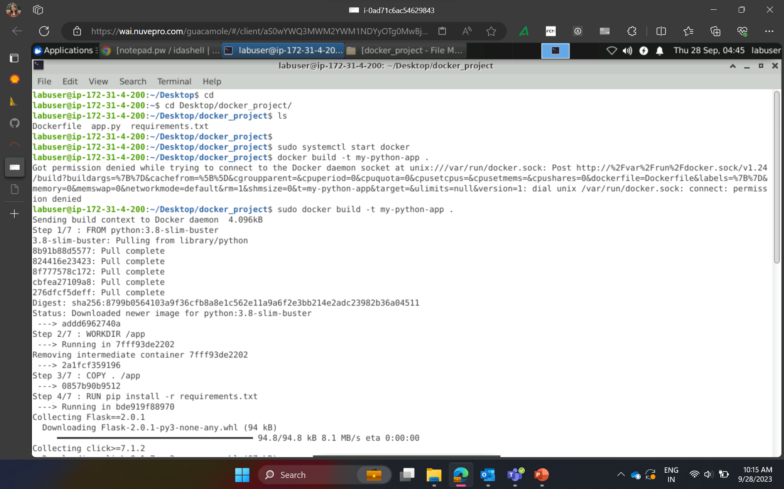








Slide 19



Slide 20
DAY-5
What is DevOps ?
Collaborative Branch (Main branch)
Feature branch
Azure DevOps
Boards
Repos
Pipelines
Test plans
Creating a project Board in Azure DevOps
Work items
Epic
Feature
User story
Tasks
Azure Repos
Azure Pipelines
Azure Deployment / DevOps

Slide 21





Slide 22
Thank You

